Slide 1

Step Two: Strategy

Slide 2

Step Two Tasks:
Conduct Scenario Planning
Develop the Customer Value Proposition
Develop a Strategy Profile
Choose Balanced Scorecard Perspectives
Choose High Level Strategic Themes and Results
Incorporate new Change Management
Planning into Strategy Development

Slide 3
What is Strategy?
Positioning choices made (the path) and action taken (the plan) to move the organization from its current state to some future desirable state

Slide 4
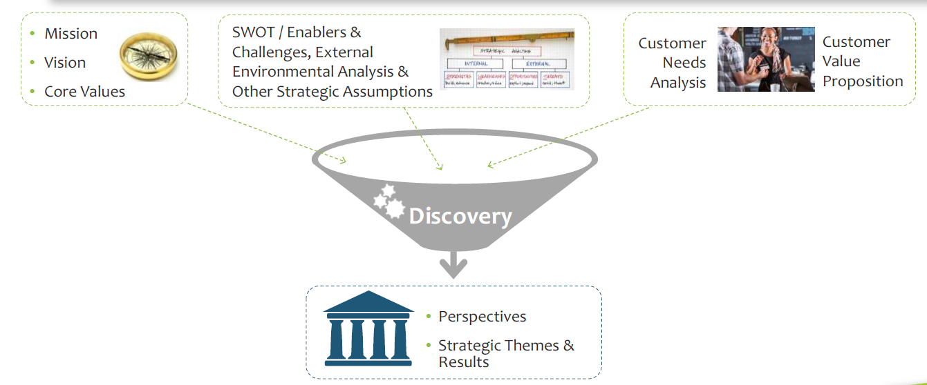
Formulate Strategy Through a Process of Strategic Thinking & Discovery

Slide 5

Characteristics of Good Strategy
Expressed as a path and a plan to move from a current state to a future state, addressing the question “How will we achieve our vision and mission?”
Bridges the gaps between mission and vision and operational implementation of activities and tasks
Focuses on “End states” that are written as easy to understand, simple statements of intent, rather than specific activities or tasks
Is NOT a listing of projects, programs, or activities
Expressed in the form of:
  A few (typically 3-4) main strategic themes, or focus areas, that answer the question: “In what key areas must we excel in delivering high value to our customers?”
  A corresponding set of strategic results, stated in results language

Slide 6
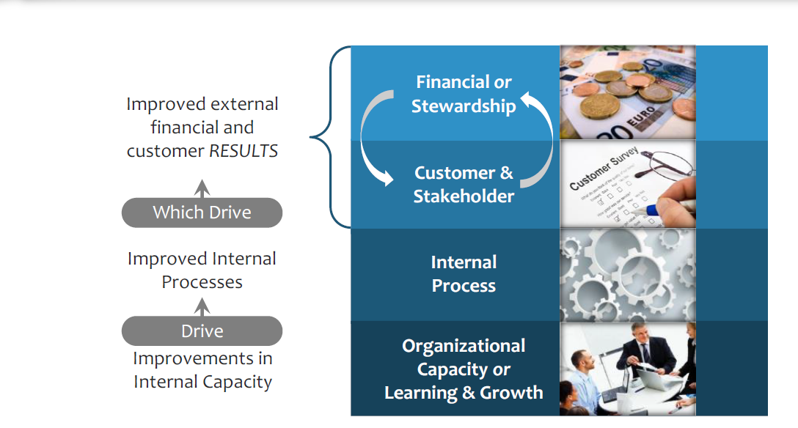
Strategy Builds Value From the Internal to the External

Slide 7
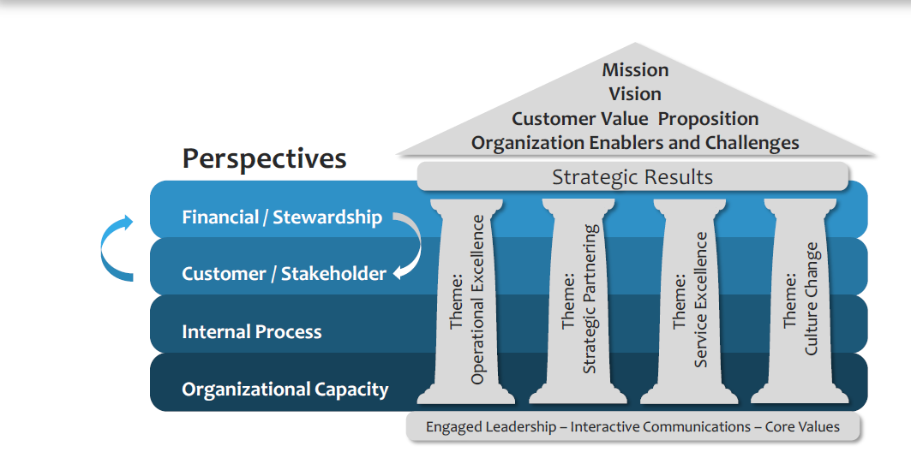
Building a Scorecard System is Like Building a Custom House

Slide 8
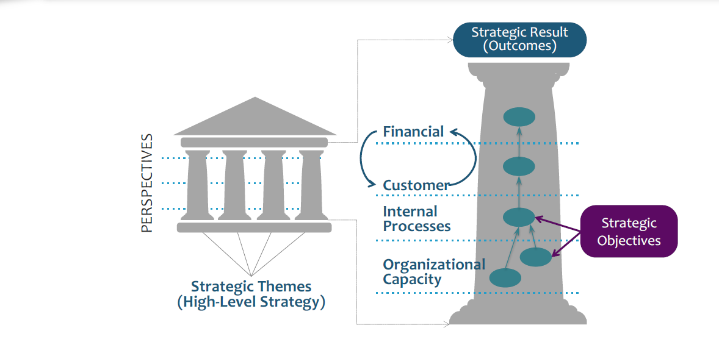
Well Executed Strategy Leads to Desired Strategic Results

Slide 9
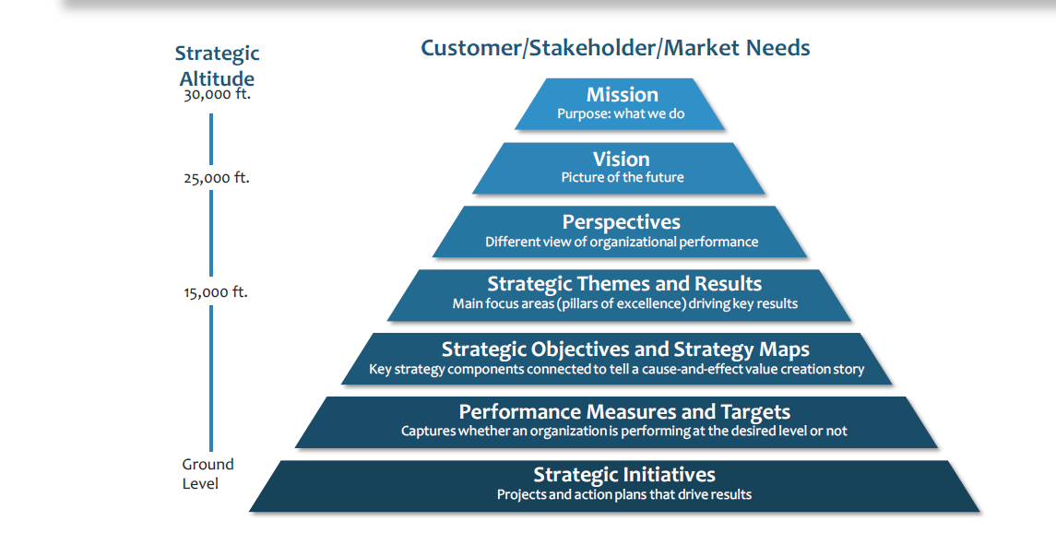
The Logic Of Integrated Strategic Planning & Management With A Balanced Scorecard

Slide 10
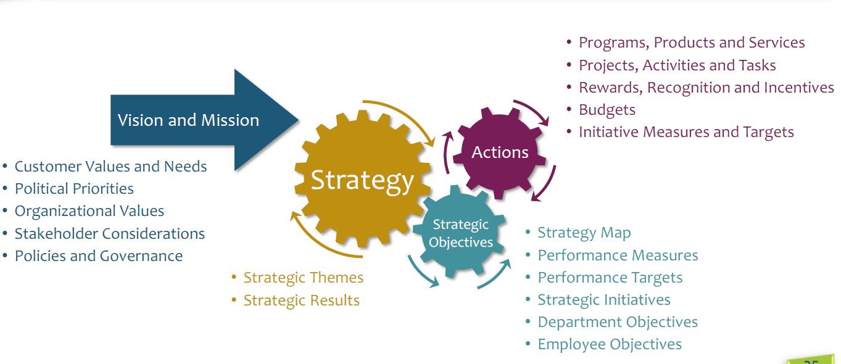
Align the Organization to Mission, Vision & Strategy

Slide 11
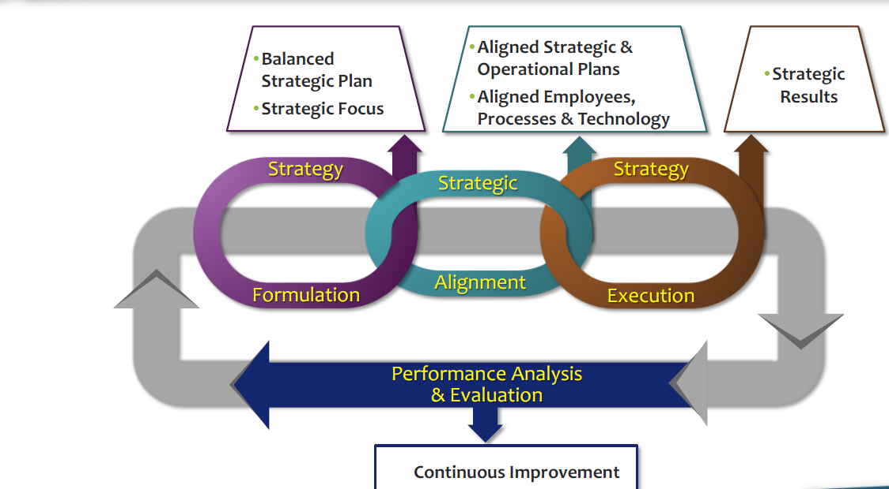
A Strategy Focus Drives High Performance

Slide 12
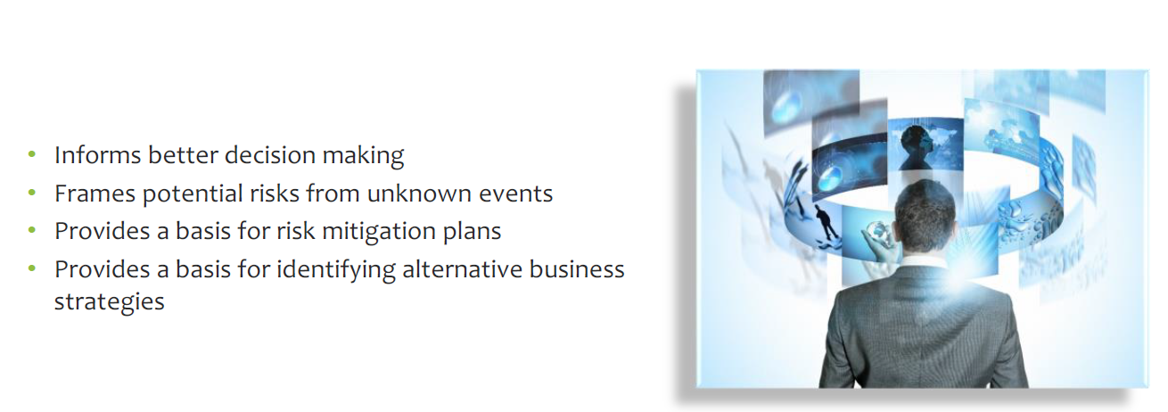
Task 1: Conduct Scenario Planning

Slide 13

Scenario Planning
Scenario planning is a powerful tool for anticipating and managing change on an industry level or environmental level, and scenario thinking is the strategic perspective necessary in today’s turbulent business environment.
Scenario thinking incorporated into scenario planning is useful in almost any strategic question in today’s businesses.
Scenario planning is clearly the link between futures thinking and strategic action , between creative, innovative and imaginative futurizing and the more hands on strategic planning .
And strategic planning, or strategizing, without scenario thinking is more or less pointless.

Slide 14
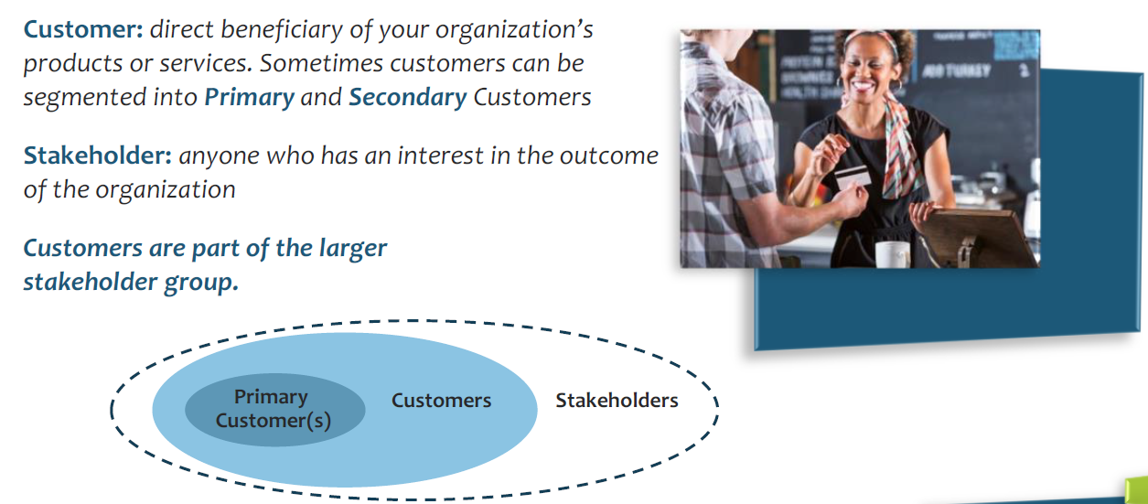
Task 2: Develop the Customer Value Proposition

Slide 15
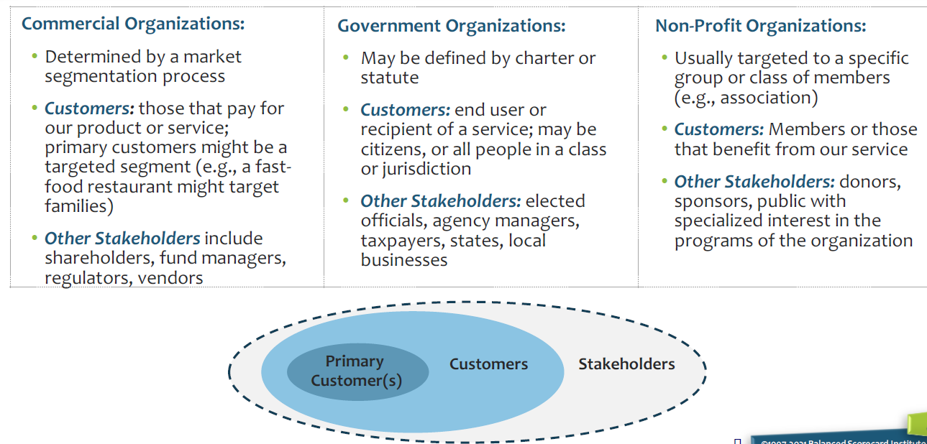
Customer & Stakeholder Examples

Slide 16
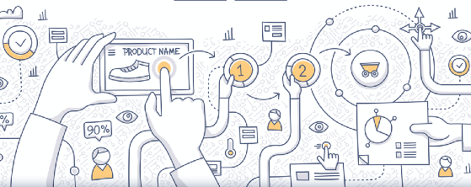


What is a Value Proposition?
A collection of the most persuasive reasons why your customers, and potential customers, should be interested in what you have to offer, in terms of:
Attributes
The problem that you can solve and how it will improve the current situation.
The things that make you stand out from the competition.
The unique attributes and the benefit they provide.
Relationship
What you provide that no one else can.
What you can do that is different from what others can provide
Image
How you expect your audience to see you as well as how you see yourself.
Use clear language and do not use jargon.
Notes:
© Intrafocus Limited 2018. Please do not copy without permission

Slide 17
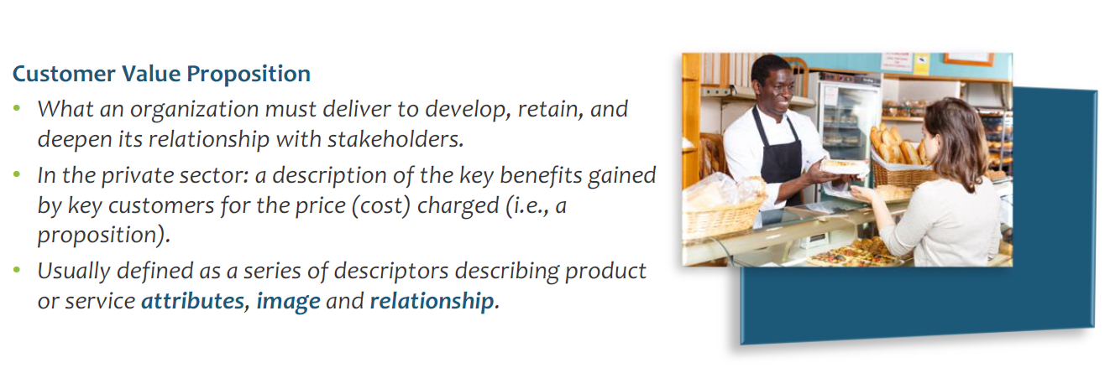
It is Critical to Define Your Customer Value Proposition

Slide 18
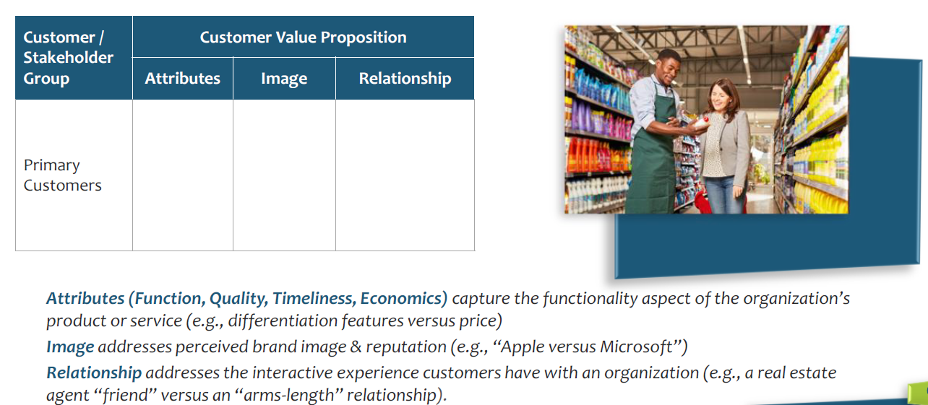
It is Critical to Define Your
Customer Value Proposition

Slide 19
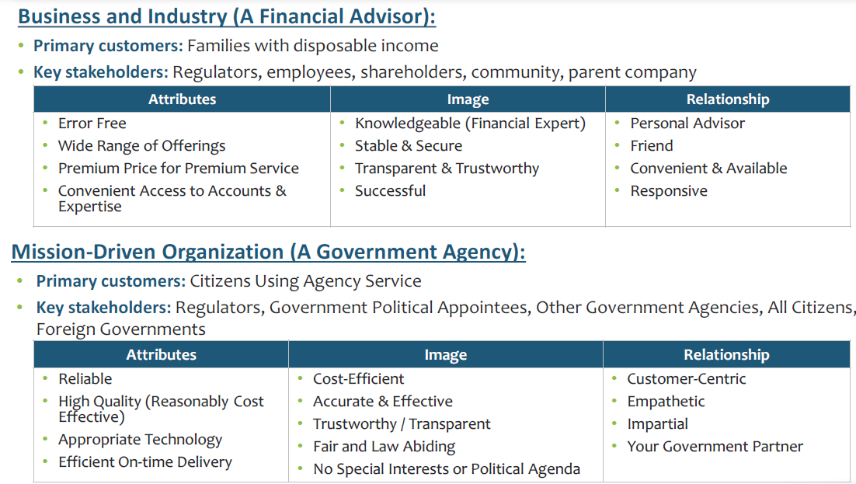
Customer Value Proposition Examples

Slide 20
Exercise – Develop Our Value Proposition
Objective: Describe the ‘Elements’ of a Value Proposition
Attributes - What are the key Attributes of your offering that could be used to help create your value proposition? (Spend most of your time here)
Relationship and Image - What are the key Relationship and Image intangibles for your organisation that could be used to help create your value proposition?
Attributes
Relationship
Image
Relevant
Unique Services
Great Access
Available 24/7
Personal Advice
Responsive
Trustworthy
Successful
Stable
Notes:
© Intrafocus Limited 2018. Please do not copy without permission

Slide 21
Task 3: Develop a Strategy Profile

Slide 22
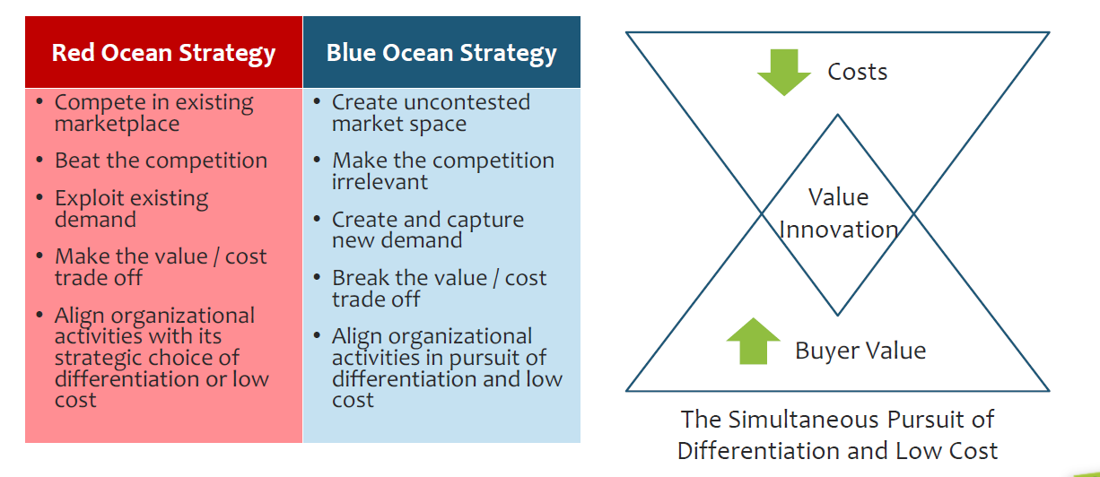
Create “Blue Oceans” by Simultaneously Pursuing Differentiation and Low Cost

Slide 23
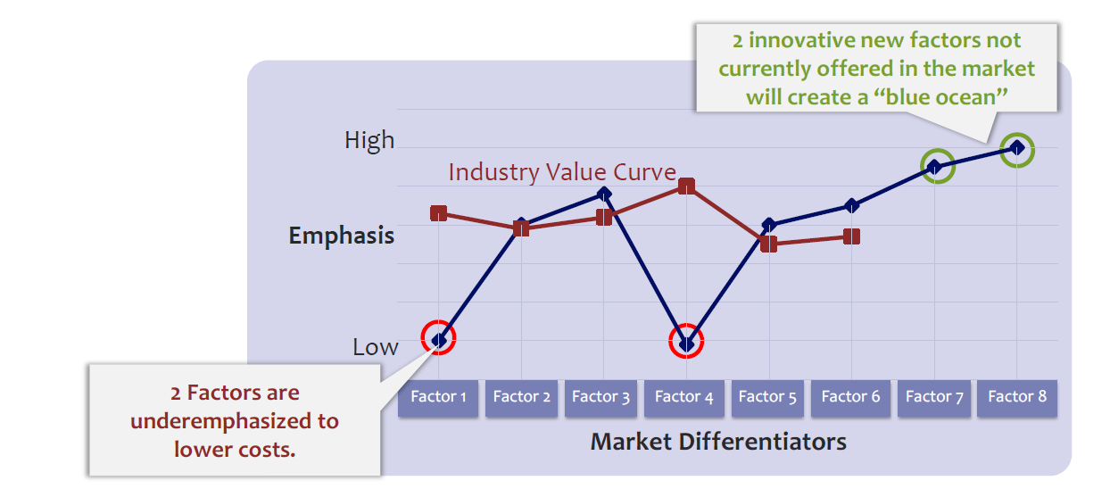
Create “Blue Oceans” by Simultaneously
Pursuing Differentiation and Low Cost

Slide 24
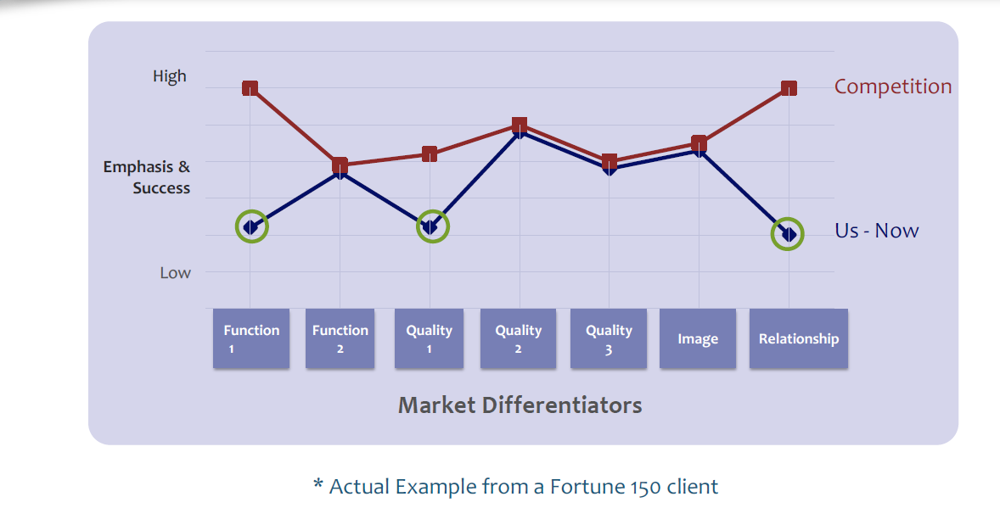
A Strategy Profile Can Identify Weaknesses

Slide 25
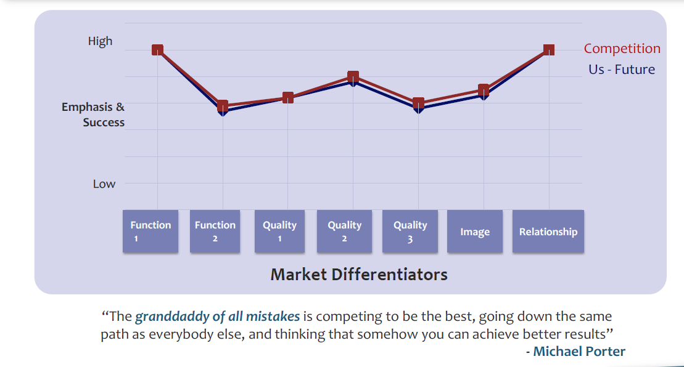
Strategy is NOT About Doing the Same Thing As Everyone Else

Slide 26
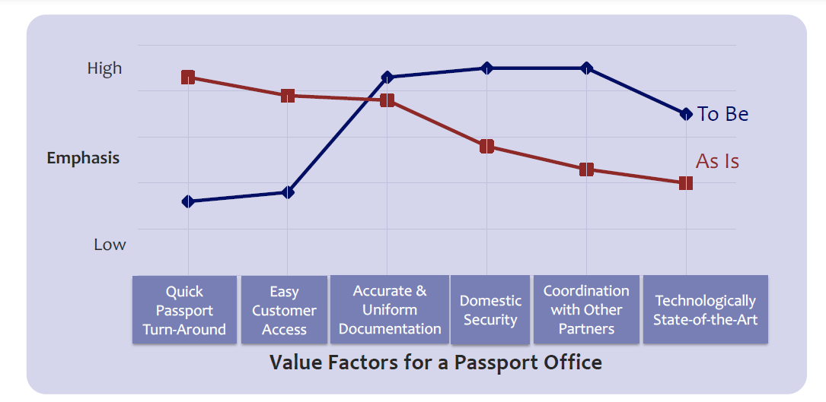
Strategy Profiles Can Compare “As Is” Against “To Be” in a Single Organization

Slide 27
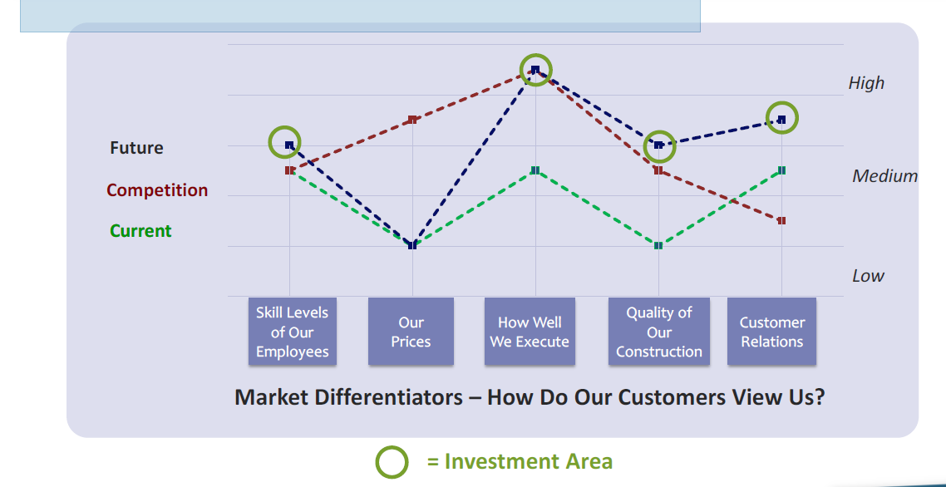
Example: Construction Company
Strategy Profile

Slide 28
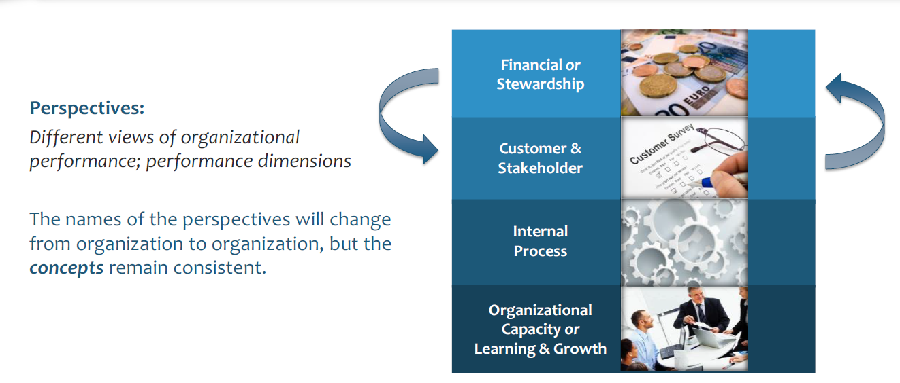
Task 4: Choose Balanced Scorecard Perspectives

Slide 29
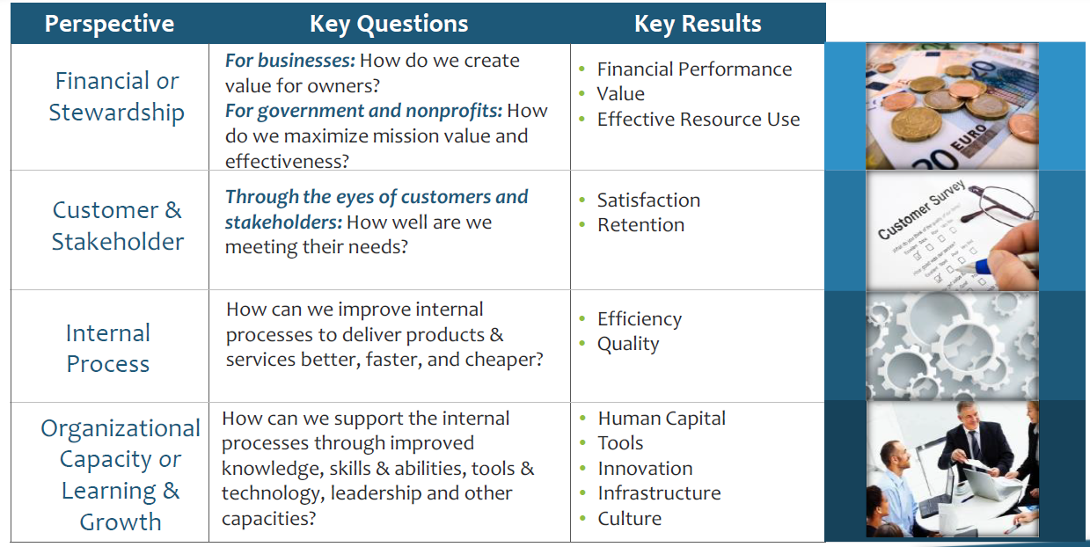
Strategy Has Four Dimensions Called Perspectives

Slide 30
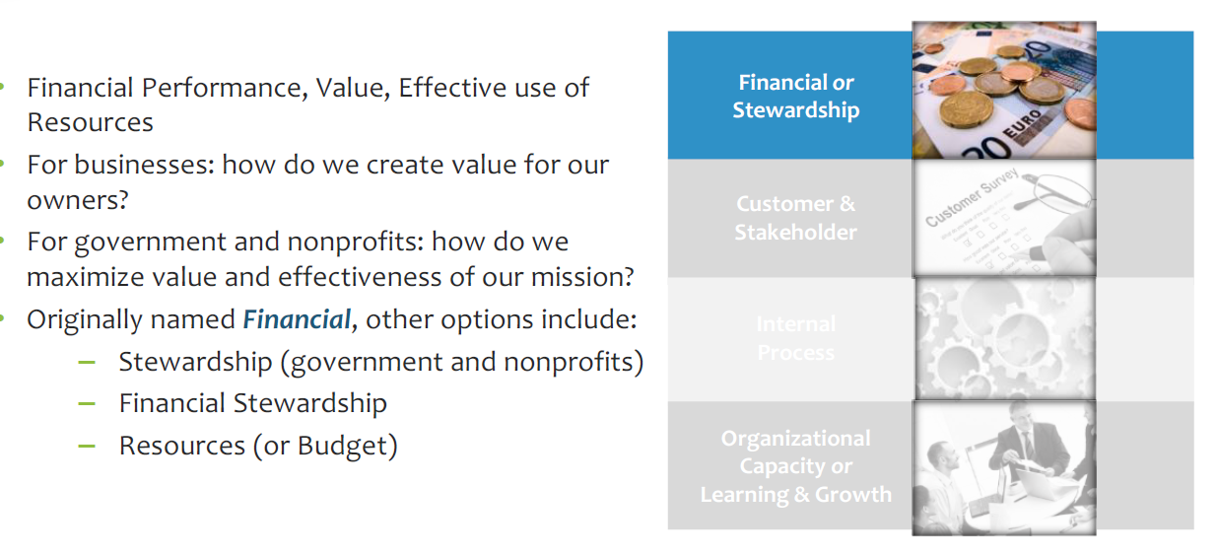
The Financial Perspective

Slide 31
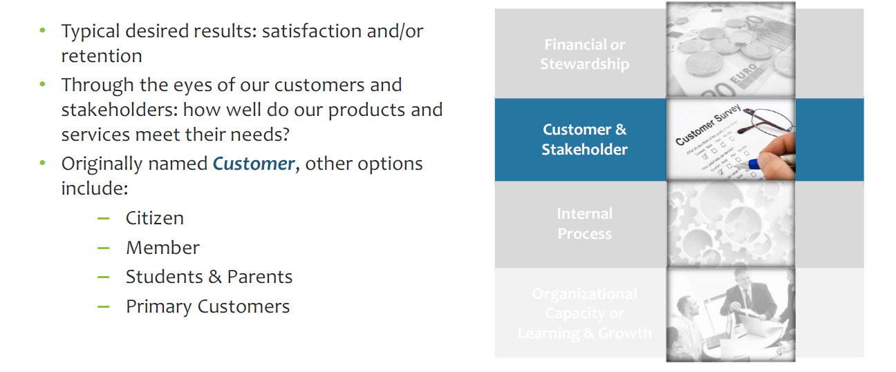
The Customer & Stakeholder Perspective

Slide 32
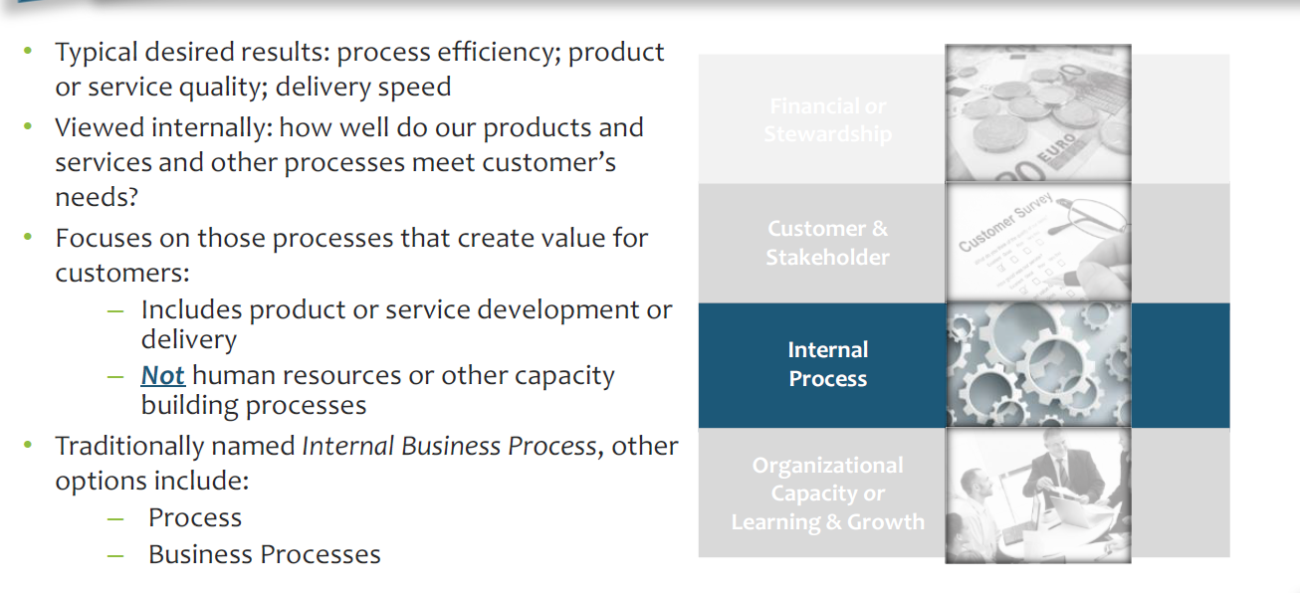
The Internal Process Perspective

Slide 33
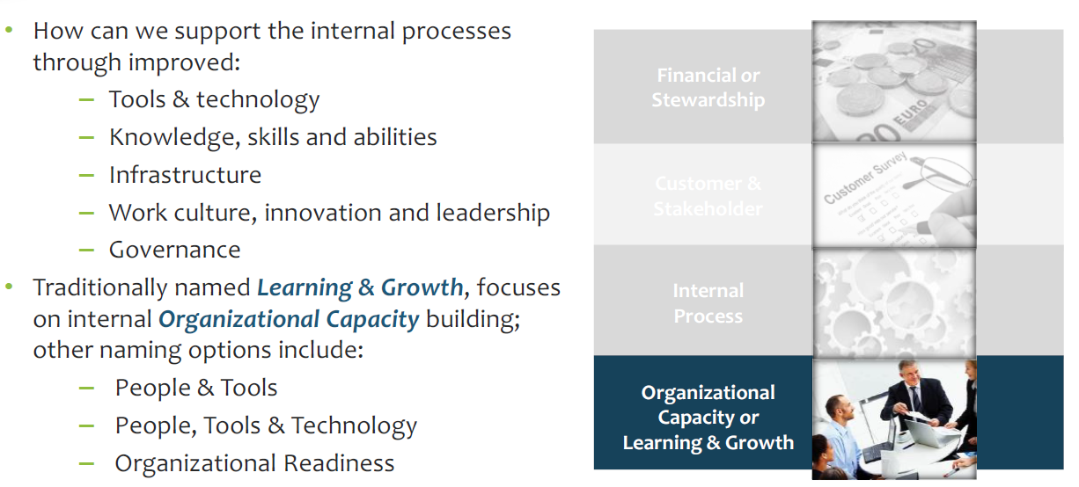
The Organizational Capacity Perspective

Slide 34
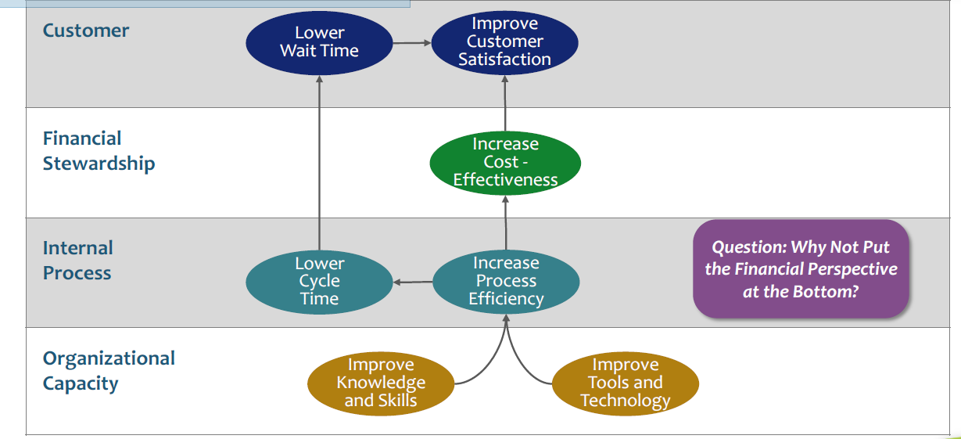
Financial Considerations Should be Mapped as a Result, at Government or Non-Profit Organizations

Slide 35
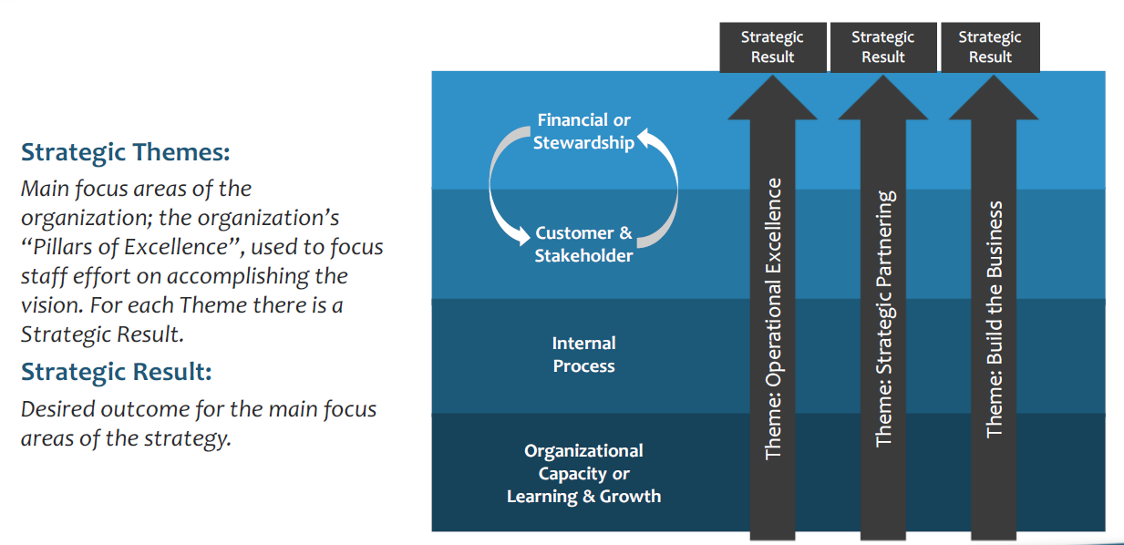
Task 5: Choose High Level Strategic Themes & Results

Slide 36
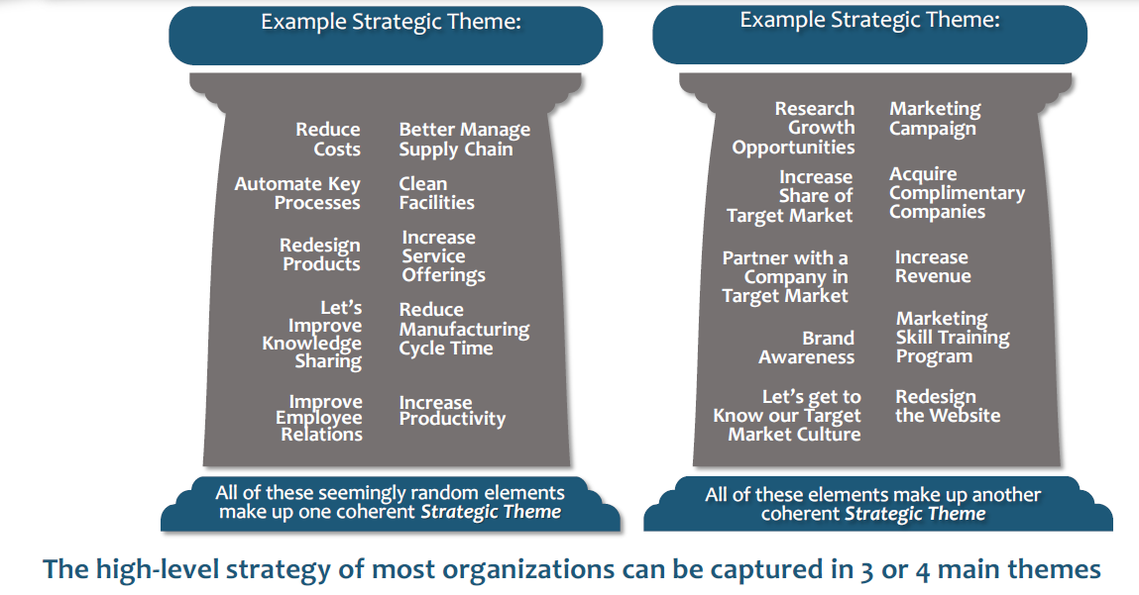
Various Strategic Elements Work Together as a Theme

Slide 37
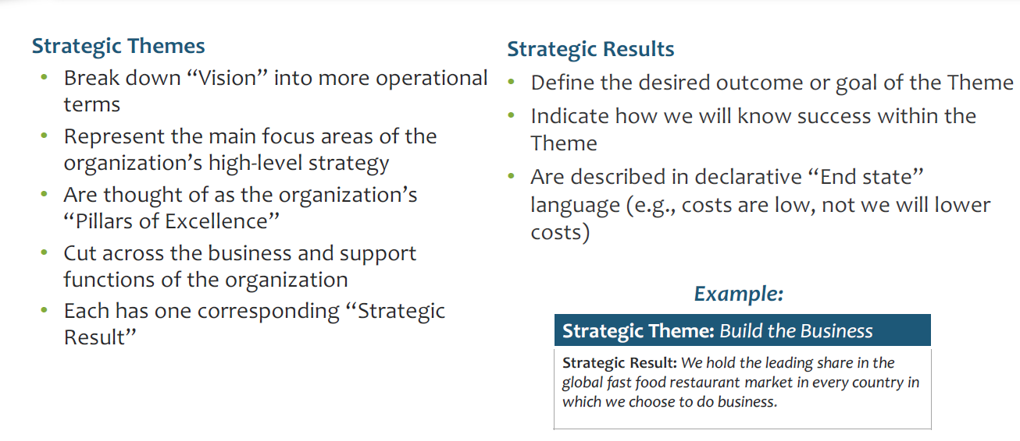
Characteristics of Good Strategic Themes And Results

Slide 38
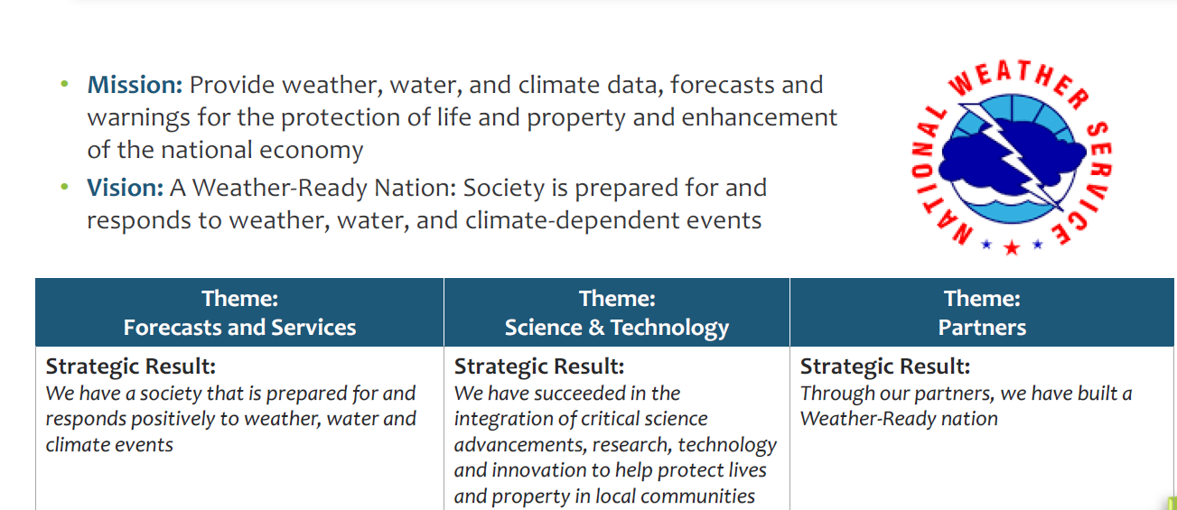
Example: The National Weather Service (NWS) Strategic Themes and Strategic Results

Slide 39
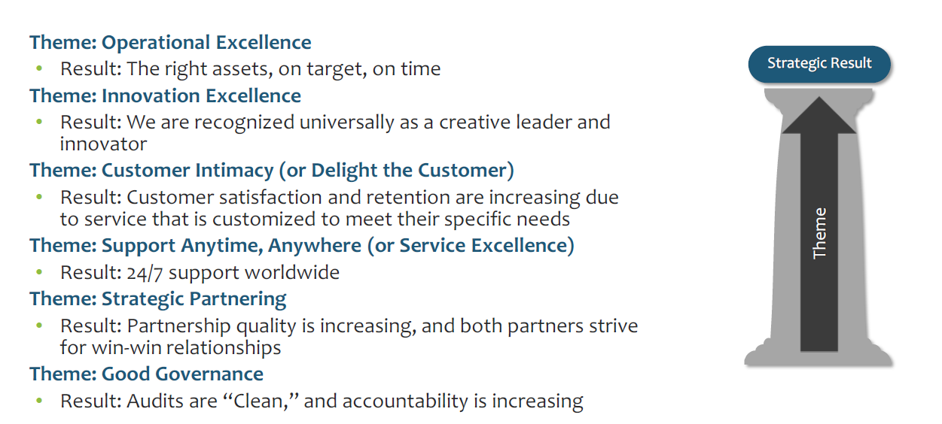
Other Common Examples of Themes & Results

Slide 40
Examples of Strategic Priorities/Themes/Pillars
Operational Excellence
  Result: Perfect delivery on target, on time and at the right cost
Customer Satisfaction
  Result: Customer satisfaction and retention increased due to customised services based in individual customer needs
Service Excellence
  Result: No problem is too small, customer services available 24 hours a day and 7 days a week
Team Culture
  Result: Highly skilled and motivated people attracted to work and stay in our business
Outstanding Governance
  Accountability is clear, audits are always passed and processes are properly documented
Grow the Business
  Result: An established business through geographic expansion
Engaged Partnerships
  Result: Strategic partnerships established with the worlds best content providers, to include sports and entertainment
Innovation Excellence
  Result: seen by our customers as the most innovative company in our market sector. Two new products per year
Community Recognition
  Result: The local community raves about our products and services, in the news
Best Place to Work
  Result: lowest attrition rates in the industry, consistently receive more CVs than needed
Notes:
© Intrafocus Limited 2018. Please do not copy without permission

Slide 41
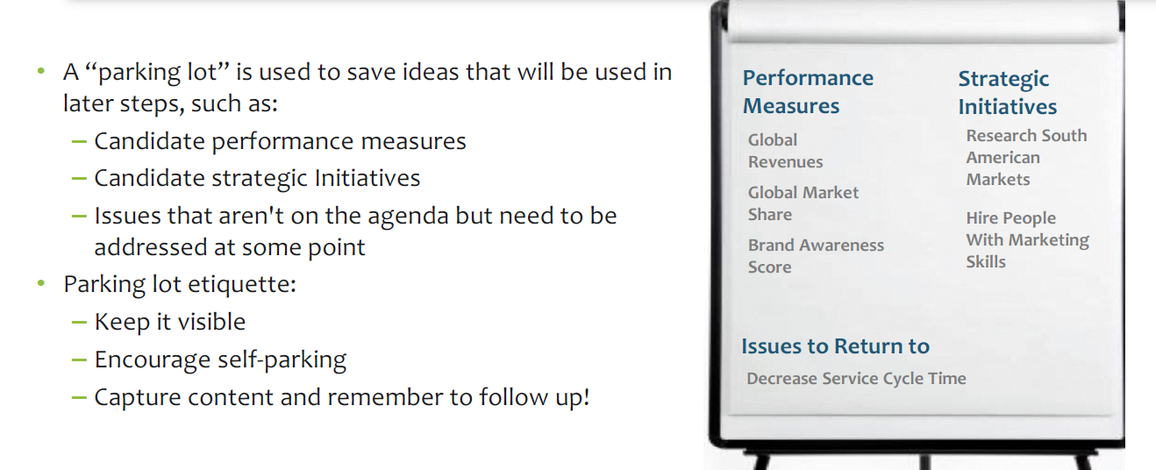
Capture Potential Initiatives and Measures on a “Parking Lot”

Slide 42
Why three Strategic Priorities/Themes/Pillars?
Why only 3 Strategic Priorities?
Law of diminishing returns – Franklin Covey:
  If you have 2-3 priorities, you are likely to achieve 2 or 3
  If you have 4-10 priorities, you are likely to achieve 1 or 2
  If you have 10+ priorities, you are likely to achieve none
To align your organisation, you need to lead from the top
  That does not mean you cannot be informed from the bottom
  In fact, it is desirable for this to happen – hence previous exercises
Grow the Business
Team Culture
Customer Satisfaction
Notes:
© Intrafocus Limited 2018. Please do not copy without permission

Slide 43
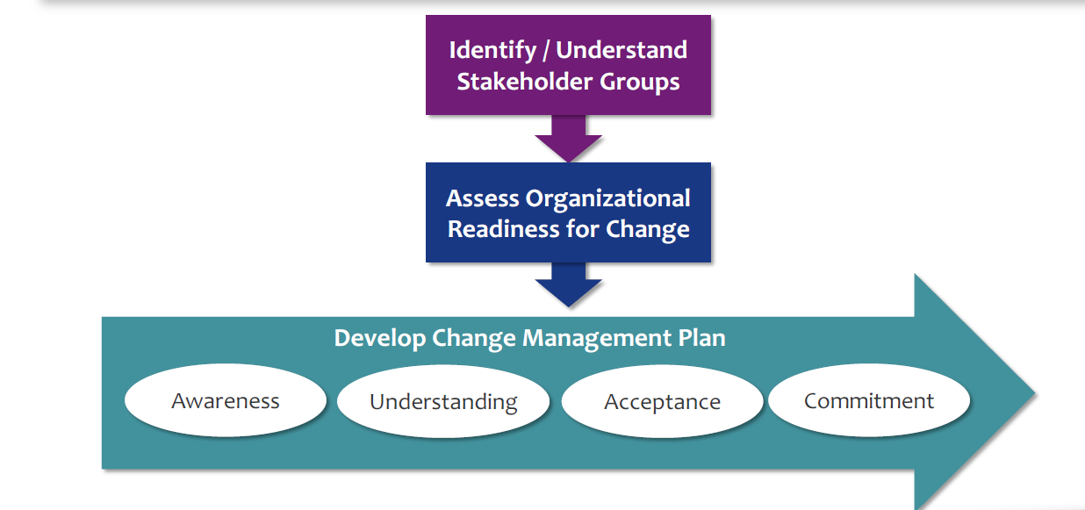
Task 6: Incorporate New Change Management Planning into Strategy Development

Slide 44
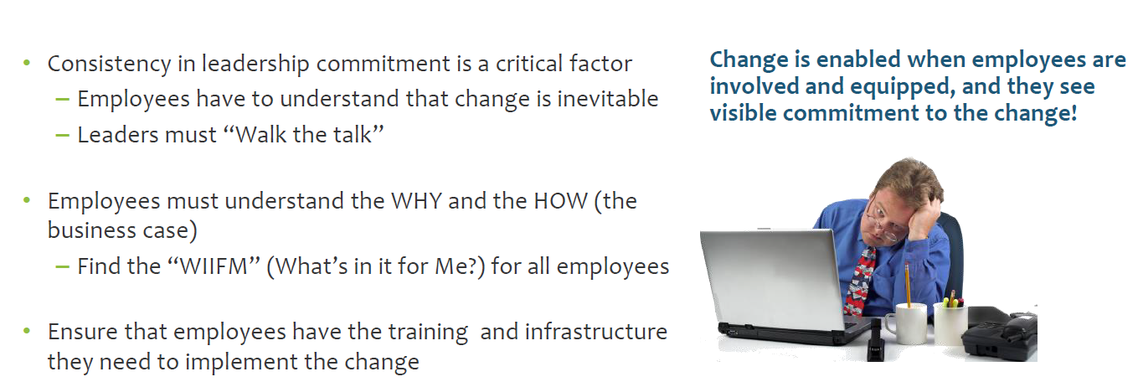
Change Management is About : Changing Hearts & Minds

Slide 45
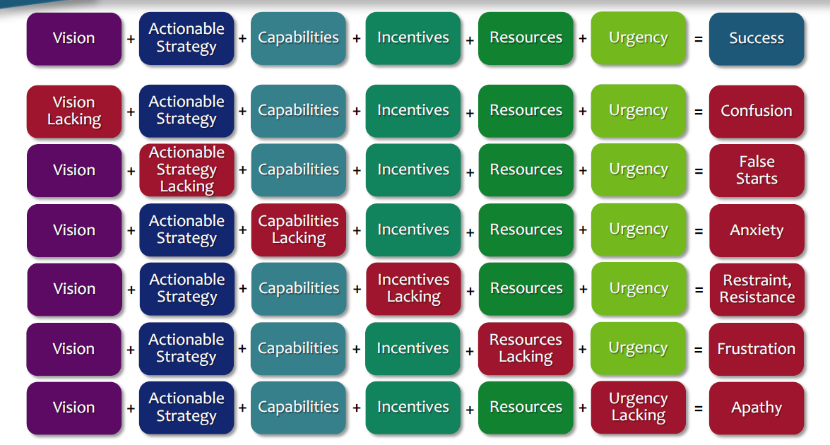
Critical Success Elements For Managing Change

Slide 46

Thank You
Questions

