Slide 1



Slide 2
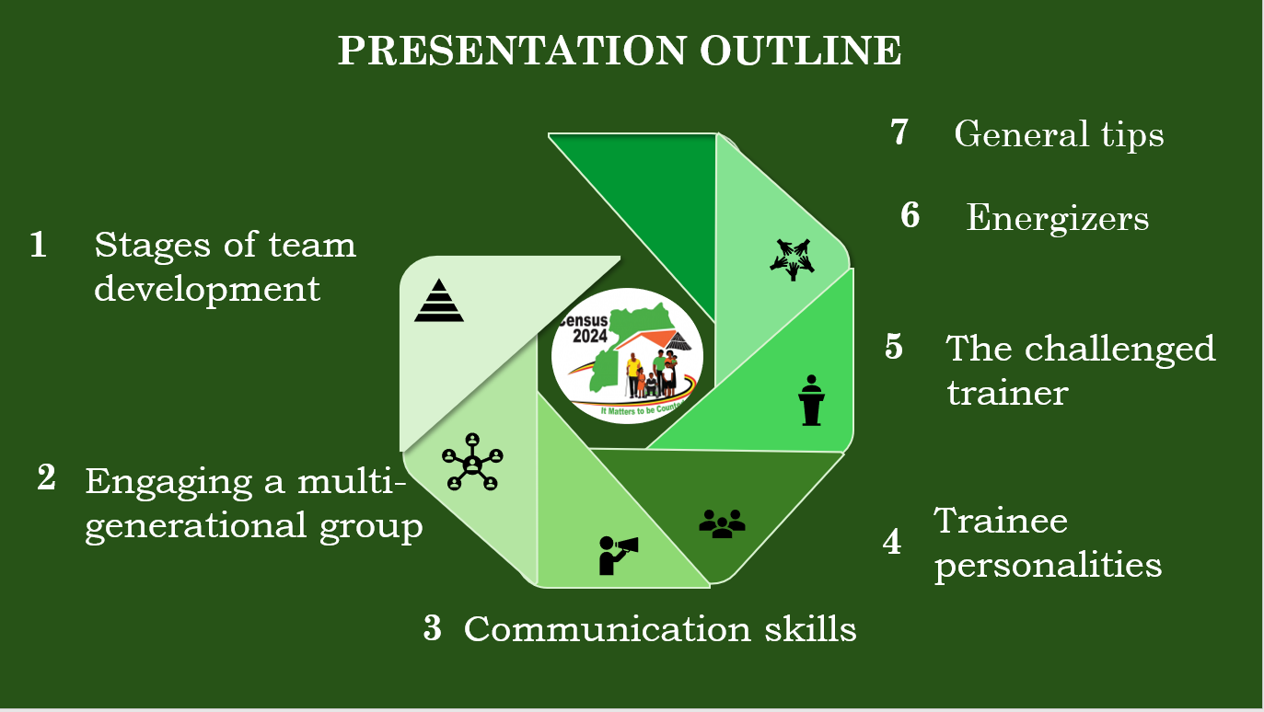
6
1
5
2
4
3

Slide 3

SESSION OBJECTIVES
To sharpen skills needed to deliver a transformative census learning experience.
To provide tips to ensure you successfully train those at the lower level.

Slide 4
Congratulations, team!
You have successfully completed the census training
Its now your turn to empower others.
Are you
    Eager to work
    Dependable / Reliable,
    Dedicated
    Independent

Slide 5
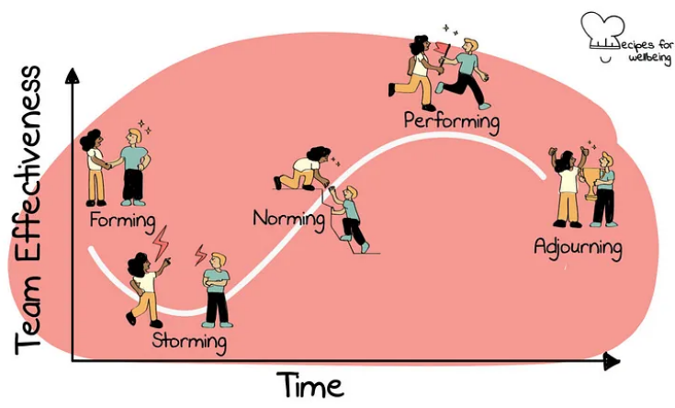
STAGES OF TEAM DEVELOPMENT

Slide 6

Engaging a multigenerational census workforce
GENERATION Z
2001 – beyond
18 to 23 years
MILLENNIALS
1981-2000
24 to 43 Years
GENERATION X
1965 - 1980
44 to 59 Years
BABY BOOMERS
1946 – 1964
60 to 78 Years
TRADITIONALISTS
1925 – 1945
79 Years +

Slide 7
A MULTI – GENERATIONAL CENSUS WORKFORCE
The census workforce is likely to span the different generations. Such as (Senior 4 and 6 leavers, fresh, young and old graduates will be working side-by-side with parents and grandparents).
Its essential to manage all these generations for the Census’s overall success
Each generation has a different set of priorities, which presents unique management.

Slide 8
Engaging a multigenerational
census workforce
Understand the generational differences | Unique communication styles (Adopt to slang to style to format (using emojis). Attitudes towards technology (content creation) View everyone as an individual
Promote Intergenerational mentorship and knowledge sharing | Capitalize on the unique wealth of knowledge and life experiences from each generation Elders may provide useful contacts and location, local knowledge and perspectives Young ones can help get grips with recent technology innovations

Slide 9
Engaging a multigenerational
census workforce
Embrace adaptability and flexibility in diverse situations | Engage all participants regardless of their age or background Give examples that resonate with participants from different age groups.
Establish a two-way Respect | Young ones should respect elders' seniority and experience WHILE elders should adjust to and respect the talented and potential for the young one Respect boundaries i.e. ethnicity, sex, age, religion, disability, personality, and educational background

Slide 10
Engaging a multigenerational
census workforce
Demonstrate /leverage empathy and emotional intelligence | Accommodate the diverse needs and preferences As a trainer you should not recognize one reason as more important than the other
Provide constructive feedback | Deliver feedback in a supportive and encouraging manner Avoid making criticisms, especially in a public setting. Soliciting feedback from participants
Grasp the core principles for both adult and young learners

Slide 11
COMMUNICATION SKILLS
Verbal communication is very crucial when discussing all census technical terms and concepts
Nonverbal cues like body language, facial expressions, and tone of voice play an important role in conveying emotions and attitudes
Pay attention to both verbal and non-verbal cues to gauge level of interest, comprehension, concerns, and understanding

Slide 12
CONTENT
ACTIVE LISTENING
CLEAR & CONCISE COMMUNICATION
VERBAL COMMUNICATION SKILLS

Slide 13
VERBAL COMUNICATION
Have an in-depth knowledge of the census concepts and definitions,
Break it down.
  Think back how you learnt the concepts, what were the key steps
Practice pronouncing difficult words in advance. i.e. microcephalus, prada-willi syndrome, Epizooties
CONTENT
ACTIVE LISTENING
CLEAR & CONCISE COMMUNICATION

Slide 14
VERBAL COMUNICATION
REHEARSE, REHEARSE, REHEARSE!
  Time yourself and ensure you cover everything within the allotted time.
Perform a pre-presentation session with peers and ask for feedback
CONTENT
ACTIVE LISTENING
CLEAR & CONCISE COMMUNICATION

Slide 15
VERBAL COMUNICATION
Demonstrate active listening skills
You have two ears and one mouth so that you can listen twice as much as you speak
listen and comprehend, then respond correctly
CONTENT
ACTIVE LISTENING
CLEAR & CONCISE COMMUNICATION

Slide 16
GESTURE
POSTURE
FACIAL EXPRESSION
TONE
VOLUME
PACE
PAUSE
EYE CONTACT
NON – VERBAL COMMUNICATION SKILLS

Slide 17
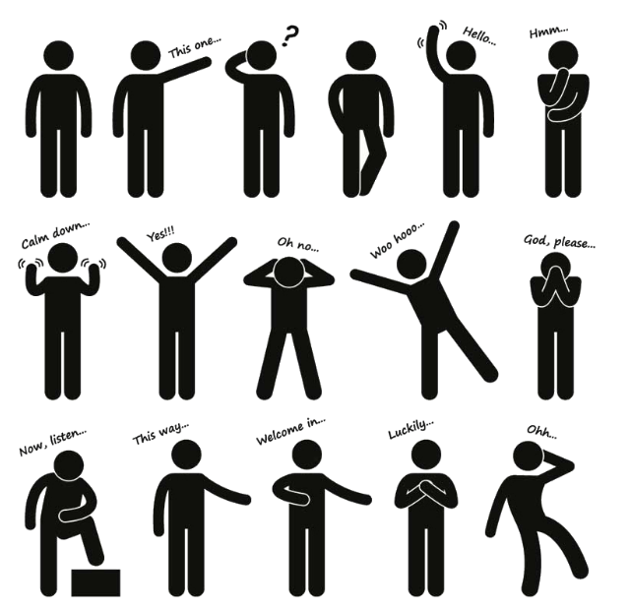
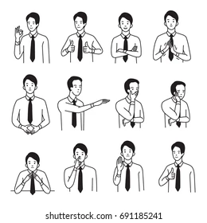
NON-VERBAL COMMUNICATION
GESTURE
POSTURE
FACIAL EXPRESSION
TONE
VOLUME
PACE
PAUSE
EYE CONTACT
Woven into our daily lives often expressing yourself without thinking.
Use them to reinforce your message

Slide 18
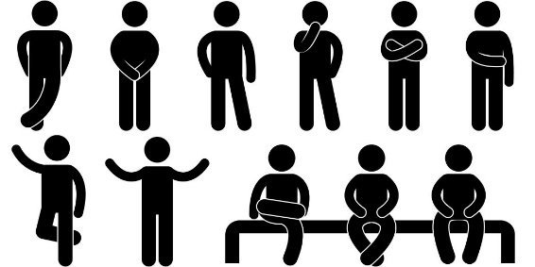
NON-VERBAL COMMUNICATION
Maintain good posture as it presents what you feel and think
Stand tall at the front of the room
Don’t sit down, lean on a desk or hide behind a stand
GESTURE
POSTURE
FACIAL EXPRESSION
TONE
VOLUME
PACE
PAUSE
EYE CONTACT

Slide 19
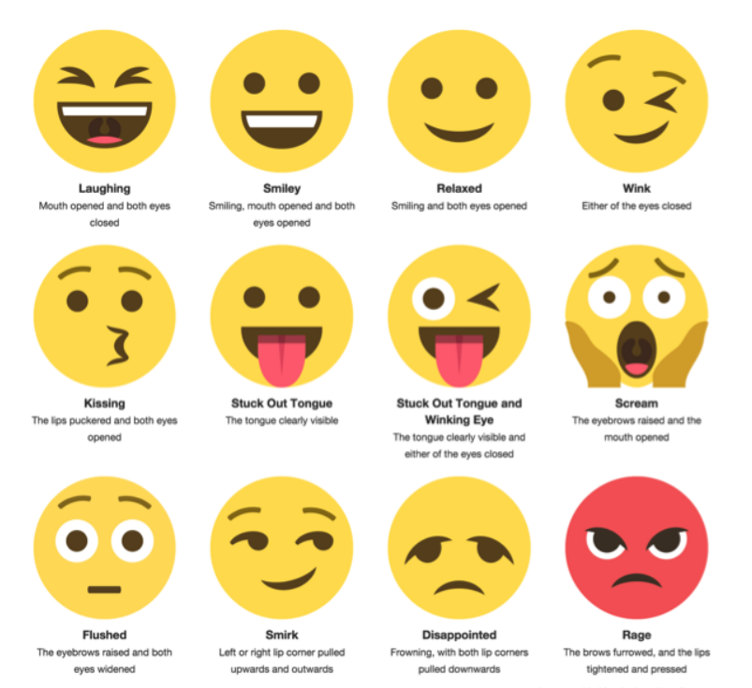
NON-VERBAL COMMUNICATION
A human face conveys countless emotions without saying a word.
Align it with the tone and content of your speech
Avoid inappropriate facial gestures
GESTURE
POSTURE
FACIAL EXPRESSION
TONE
VOLUME
PACE
PAUSE
EYE CONTACT
Notes:
Winking friendly acknowledgement, sharing a secret or joke),
Eyebrow raising,
Blinking frequently,
Pupils dilated,
Eye shrug (frustration),
Rubbing eye (disbelief, upset, or tiredness),
Widening eyes (interest, appeal, invitation)
Happiness,
Sadness,
Anger,
Surprise,
Fear, And
Disgust

Slide 20
NON-VERBAL COMMUNICATION
GESTURE
POSTURE
FACIAL EXPRESSION
TONE
VOLUME
PACE
PAUSE
EYE CONTACT
  Tone influences how the concepts are perceived and received
  It reflects the gravity of the subject matter. “Death”
  It’s not just what you say, it’s how you say it. When you speak, other people “read” your voice

Slide 21
NON-VERBAL COMMUNICATION
GESTURE
POSTURE
FACIAL EXPRESSION
TONE
VOLUME
PACE
PAUSE
EYE CONTACT
Be audible and adjust your volume based on the size of the room.
You don’t need to SHOUT to be heard, Shouting can come across as aggressive.
Participants keep quiet to listen to intelligent People.

Slide 22
NON-VERBAL COMMUNICATION
Read the manual at a normal rate of speed.
Participants are hearing the census definitions and concepts for the first time
Rapid speech may convey nervousness, while slow speech might indicate emphasis on specific points
GESTURE
POSTURE
FACIAL EXPRESSION
TONE
VOLUME
PACE
PAUSE
EYE CONTACT

Slide 23
NON-VERBAL COMMUNICATION
GESTURE
POSTURE
FACIAL EXPRESSION
TONE
VOLUME
PACE
PAUSE
EYE CONTACT
An occasional pause is very reasonable
Make strategic pauses to allows participants absorb key points,
it will give you time to breathe and gather your thoughts

Slide 24
NON-VERBAL COMMUNICATION
GESTURE
POSTURE
FACIAL EXPRESSION
TONE
VOLUME
PACE
PAUSE
EYE CONTACT
Make eye contact with your audience to enhance the impact of your speech.
Capture attention and convey confidence
Strike a balance, avoid staring down one person or scanning too quickly.

Slide 25
TRAINEE PERSONALITIES
It's essential to recognize that trainees can exhibit multiple personalities to varying degrees in different situations
As a trainer, being aware of these personalities can help you interact more effectively and foster a collaborative and inclusive environment

Slide 26


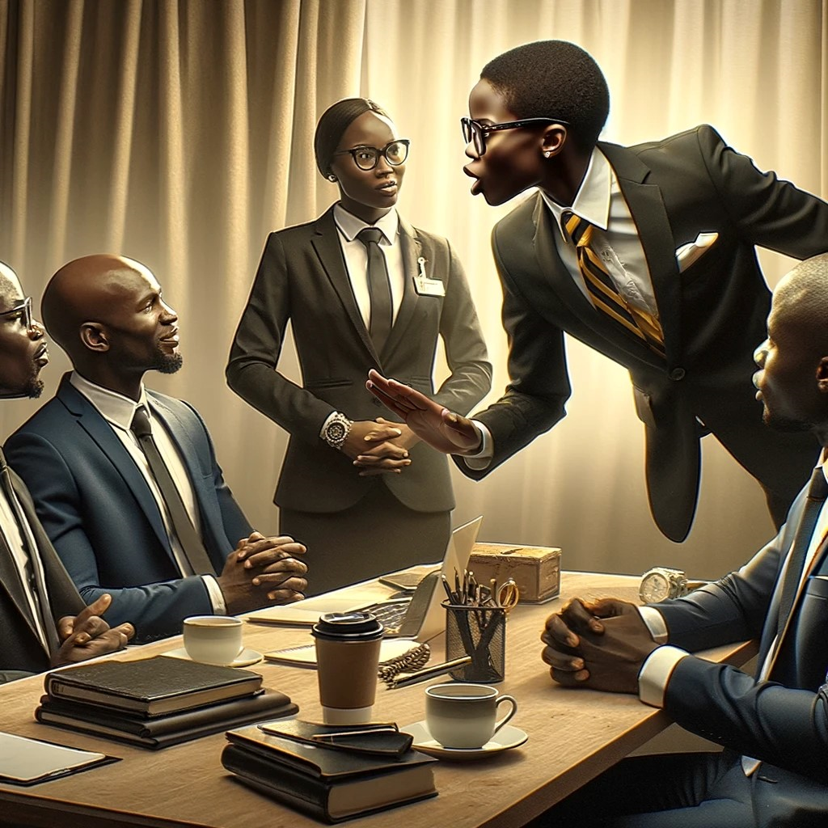



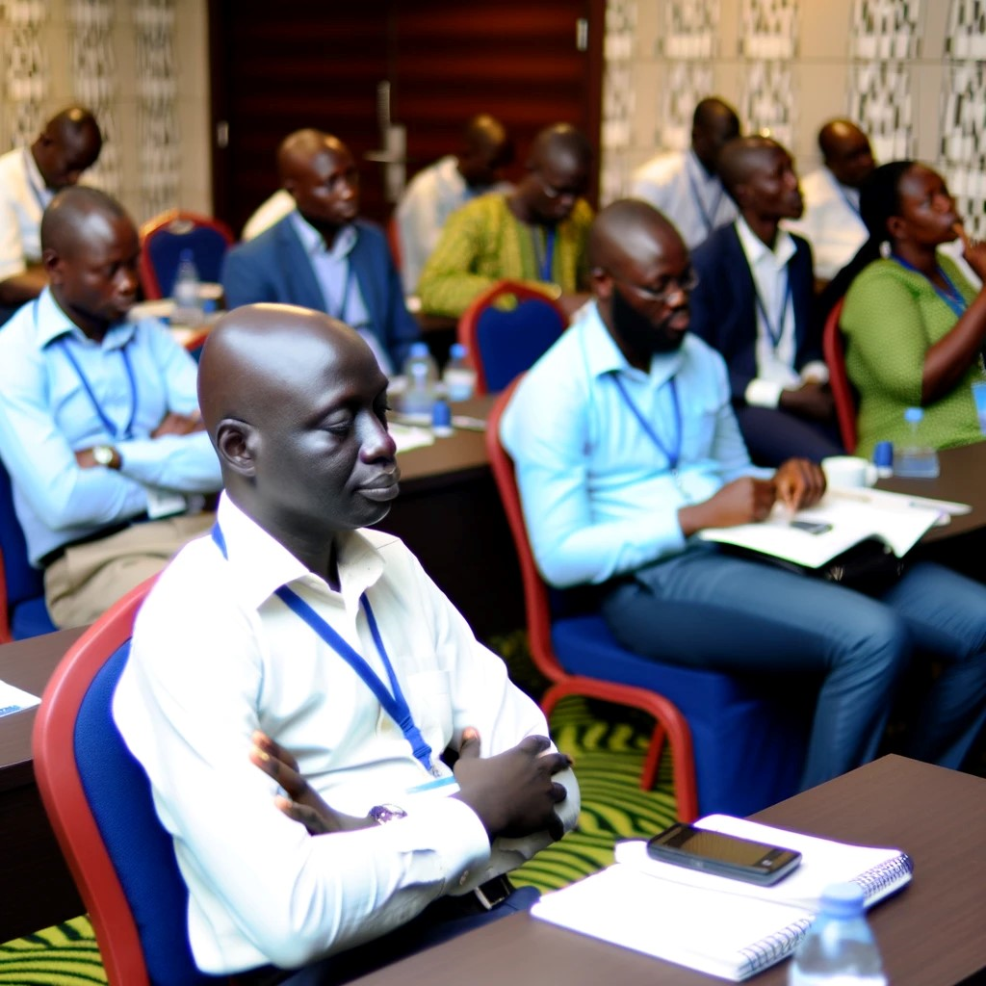
TRAINEE PERSONALITIES

Slide 27
THE TEAM PLAYER
Contributes to the trainings
Open about team dilemmas
Helps to resolve issues
Brainstorms, and
Takes on responsibilities
Utilise them

Slide 28
THE TALKATIVE OVER LOADER
Regularly wants to speak
Has assumptions for each concept
Shuts down other points of view
Speaks for long periods of time, if given an opportunity
Interject when others are answering
Establish rules for respectful communication
Ensure they don't overshadow quieter participants and allow space for diverse perspectives.

Slide 29
THE MULTITASKER
A double-edged sword engages in other tasks. (social media, office work)
Has divided attention, impatience and may miss key concepts and definitions
Set clear expectations around attentiveness and participation
Incorporate activities that require active participation

Slide 30

THE LATE COMER
Never fails to joins
Misses key introductions or instructions
Needs to catch up always
Establish rules for time management
Offer a quick summary of any missed concepts
Try to understand the underlying reasons

Slide 31
THE SILENT OBSERVER
Quietly observes
Encourage active participation,
    Be sensitive when calling on trainees who have not raised their hands.
    Do not put a trainee on the spot that does not feel comfortable responding.
    Use the indirectly methods i.e “I have not heard from anyone from this side.

Slide 32
THE EAGER TRAINEE
An asset to the training
Highly motivated and ask a lot of questions
Fast learner and has a desire to contribute
  Do not call on the eager trainees all the time
  Encourage them to come to you with any questions or concerns

Slide 33
OVERWHELMED AND UNRESPONSIVE
Struggles to absorb and process the material
Show signs of boredom or fatigue
Take a short break, ask questions, or find other ways to keep trainees involved in the training session
Provide additional guidance
Utilise the recap – as most people respond well to hearing a critical message more than once

Slide 34
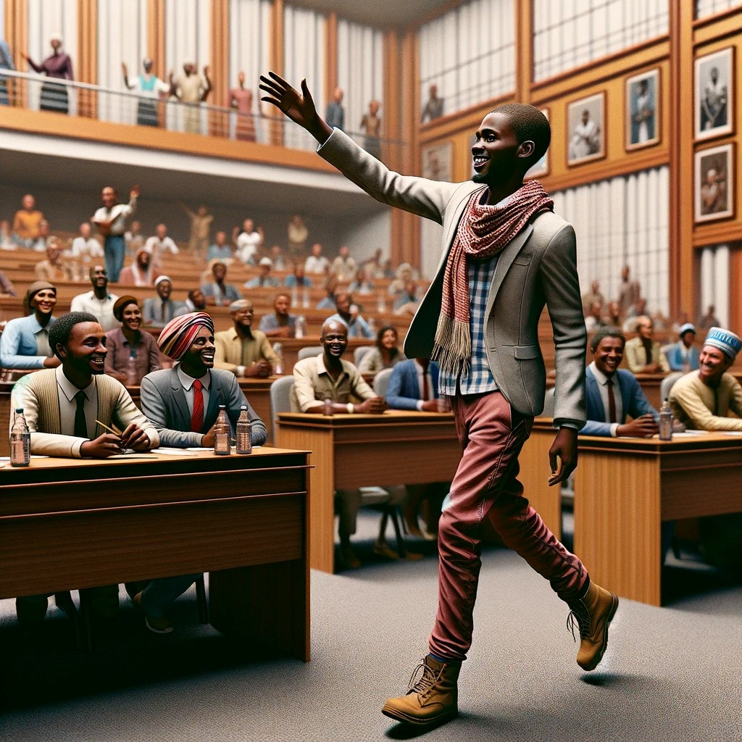
THE DISTRACTOR / TIME-WASTERS
May arrive with distractions from work, personal matters, or other factors
Makes irrelevant comments,
Diverts with off-topic remarks or jokes
Can hinder progress or derail the training
Manage potential disruptions
Do not embarrass a trainee.
Speak individually during breaks or during exercises

Slide 35

THE DEBBIE DOWNER

Slide 36
THE DEBBIE DOWNER
Has low expectations for success (we are not there yet)
Got a negative outlook on the activity
Focuses on negative aspects (No network, No electricity)
Always doubtful (shall we have data – APN data)
Brings down the mood with negativity
Tries to sabotage
Provides misleading information and disrupts the process ( UBOS wants to take 50% to build arcades)

Slide 37
THE DEBBIE DOWNER
Actively listen to their concern without judgement
Address the underlying reasons, is it steaming from past experience, lack of confidence or trust
Address these concerns directly and offer support
Use positive reinforcement (Thank you for hosting refuges., sorry about the death in the previous census.)
Do not get dragged into negativity
Use lighthearted approach to diffuse tension
Focus on the solution. Work with them to find ways to over come the challenges. (MTN and URA collaboration on the TIN)

Slide 38
THE DETAIL-ORIENTED
Has a keen eye for precision and can quickly spot errors or inconsistencies
Put their full attention on any given task and concentrate (May slow down the training)
Can anticipate problems before they arise
Showcase a high level of patience and perseverance
Do not refer them to the manual, instead equip yourself with enough information or at least be in the know of the reference page in the manual.

Slide 39
THE DETAIL-ORIENTED
Practice active listening techniques to ensure everyone's input is valued and understood.
Summarize and repeat key points to validate understanding
Foster a collaborative environment that welcomes diverse perspectives.
Help them connect the dots and see how details fit into the larger context

Slide 40
THE PASSIVE AGREE-ER
Normally follows and nods along rather than actively contributing.
Have a private conversation with the trainee
Encourage them to share their thoughts, ideas, and questions during discussions
Assign specific tasks

Slide 41

THE CHALLENGED TRAINER
Trainees may signal to doubt your training abilities, questioning key census concepts of your session
Regularly propose corrections
Demonstrate unconcerned or defiant attitudes
Training gets argumentative RATHER THAN constructive

Slide 42
THE CHALLENGED TRAINER …
Maintain the confidence
Focus on your strengths
Seek support from the census team if you feel overwhelmed
Acknowledge their concerns in a professional manner.
Adopt and use this as a learning experience to improve your training skills
Identify the source

Slide 43
  IF YOU DON’T KNOW AN ANSWER
Do not fumble around for an answer or, still worse, give the wrong one. Use the parking lot
Look up the answer with the help of the class. Throw back the question diplomatically to the class.

Slide 44
ENERGIZERS …..
Plan something every 40 minutes to stay focused and attentive.
Be mindful of ;
    The size of the group
    The time available
    The energy level of the group
    Physical space
    Age of participants
    Noise

Slide 45

  USE HUMOUR IN YOUR TRAINING
A well-placed joke can lighten the mood and improve engagement.
Avoid offensive or distractingjokes related to sports (Football), politics and religion.
Your goal is to ease the atmosphere,
not to put participants down or disrespect them

Slide 46
THANKING PRESENTERS
Verbal appreciation
Physical appreciation
  A round of applause from the participants
  Walk to the wildness and pick flowers and batch them up and reward the presenter

Slide 47

GENERAL TIPS
SMARTNESS,
RESPECT
AND
PROTOCOL
NEVER GO ON LEAVE.

Slide 48
GENERAL TIPS
Back up plan - Incase of technical failures Prepare for any eventuality
    Do a “Critical redundance” - store in multiple locations, use backup systems, version controls.
    Practice presenting without the slides
  Time management

Slide 49
2 Timothy 2:2
“Take the teachings that you heard me proclaim
in the presence of many witnesses,
and entrust them to reliable people,
who will be able to teach others also”

Slide 50
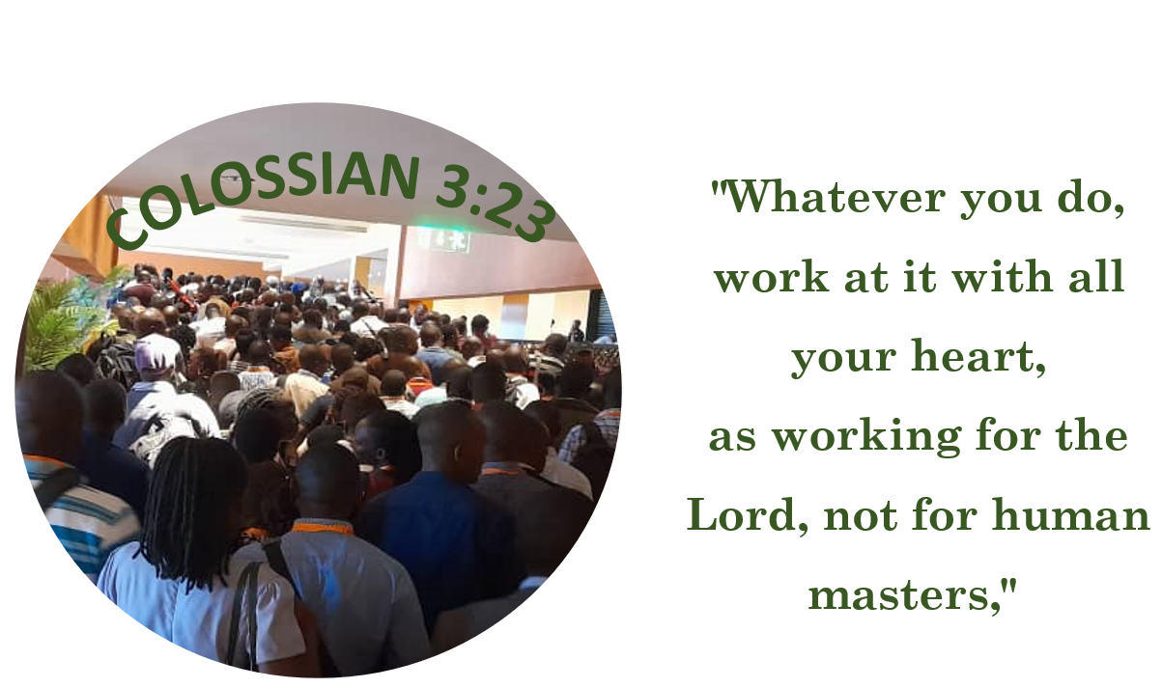

Slide 51
THANK YOU FOR LISTENING

