Slide 1
ACCOMODATION ESTABLISHMENT QUESTIONNAIRE
NPHC 2024 TRAINING

Slide 2
Introduction
This questionnaire will be administered by PAPI.
Supervisors will make the PAPIS available at the different accommodations and pick them up at a designated date.
The following steps guide on how this information will be captured into the digital system.

Slide 3
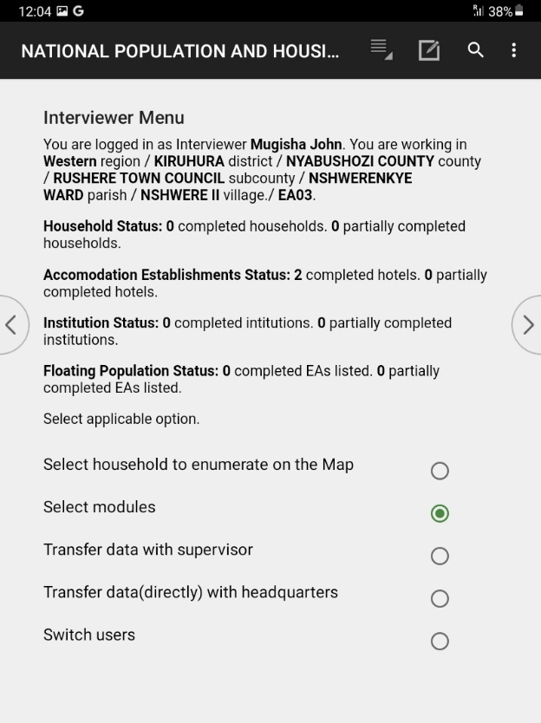
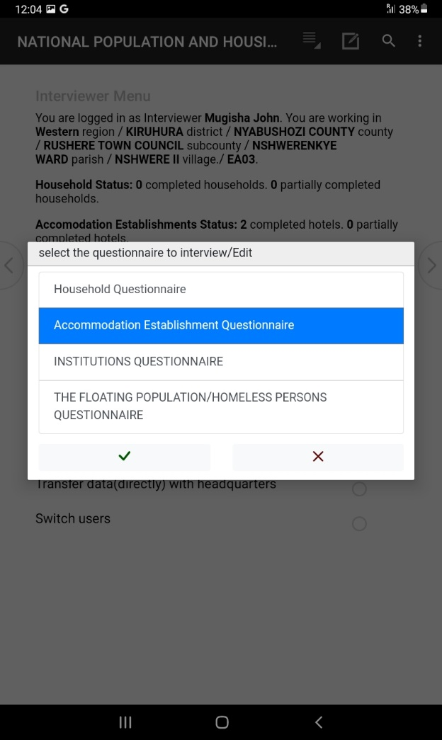
Start the accommodation questionnaire by selecting the module

Slide 4
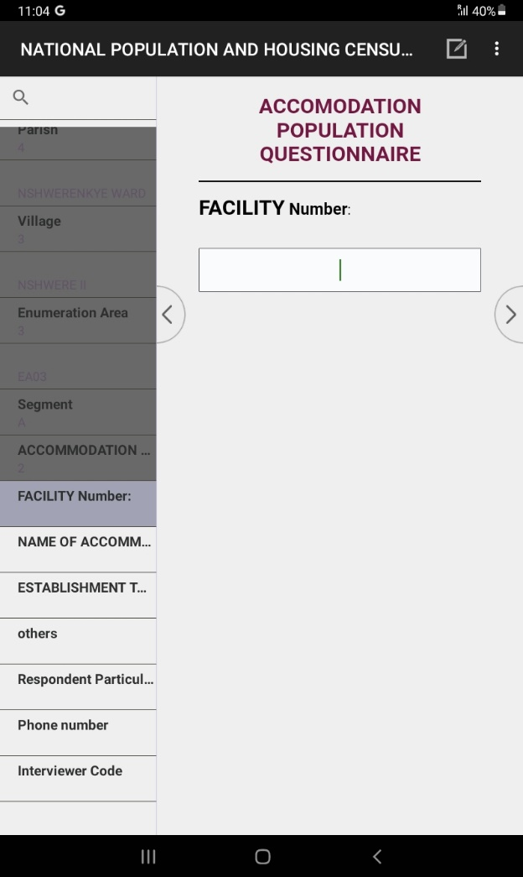
Begin the Accommodation Questionnaire

Slide 5
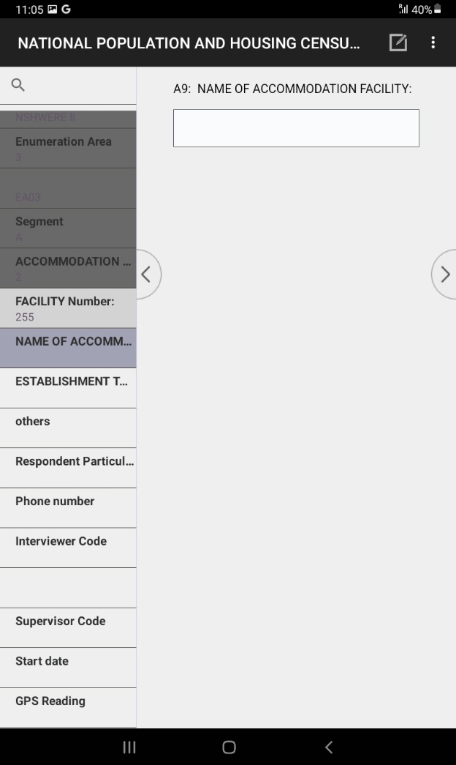
Ask For The Name of The Accommodation Facility

Slide 6
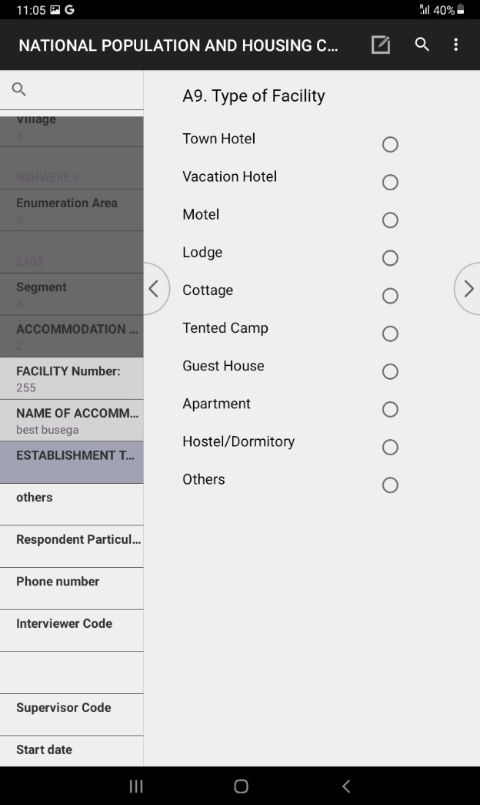
Select the type of accommodation facility your visiting

Slide 7
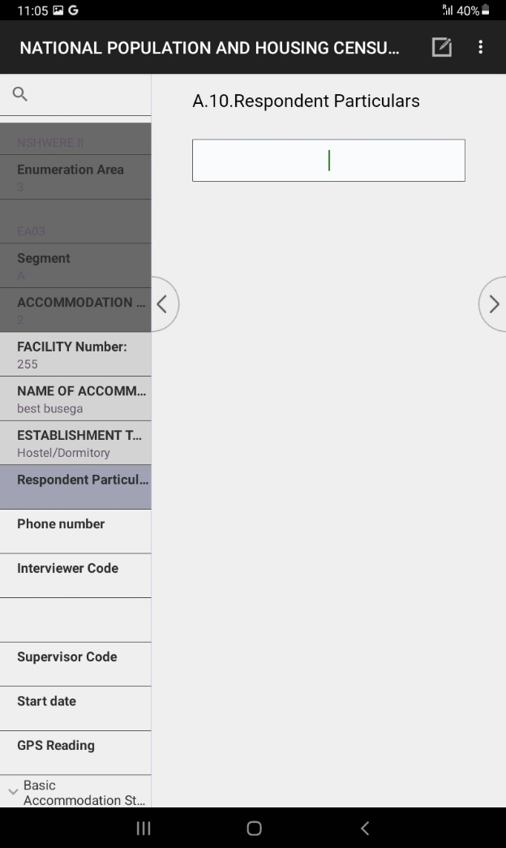
Enter the Particulars Of The Person Responding to Your Question In The Facility

Slide 8
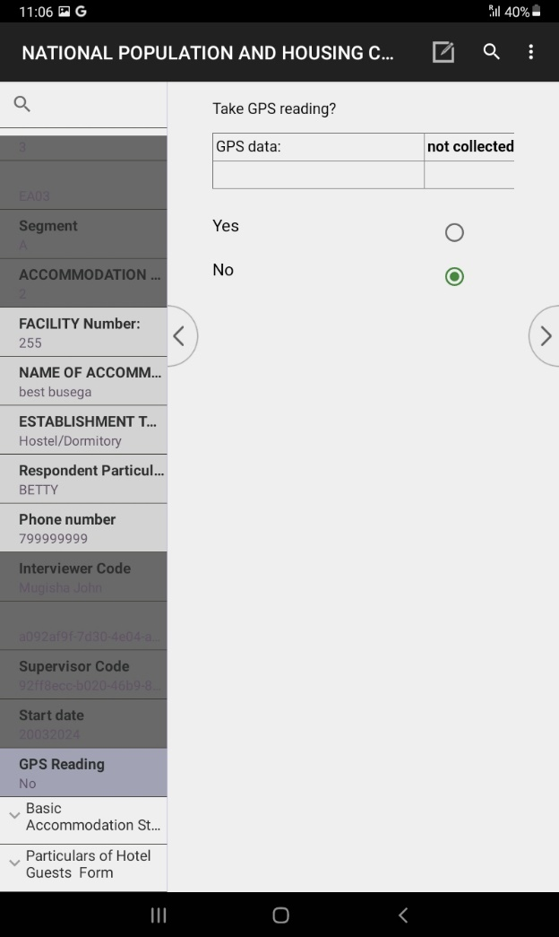
Take the GPS coordinates of the facility that your collecting data from

Slide 9
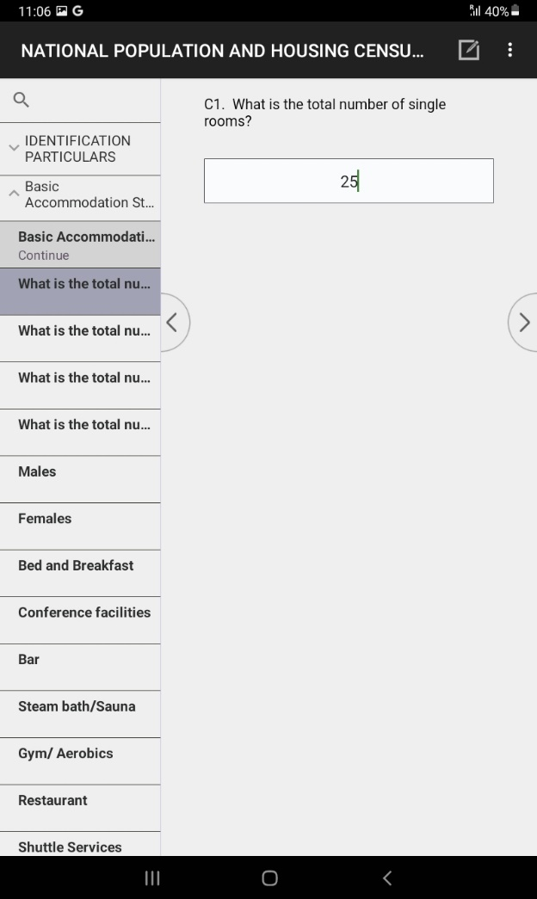
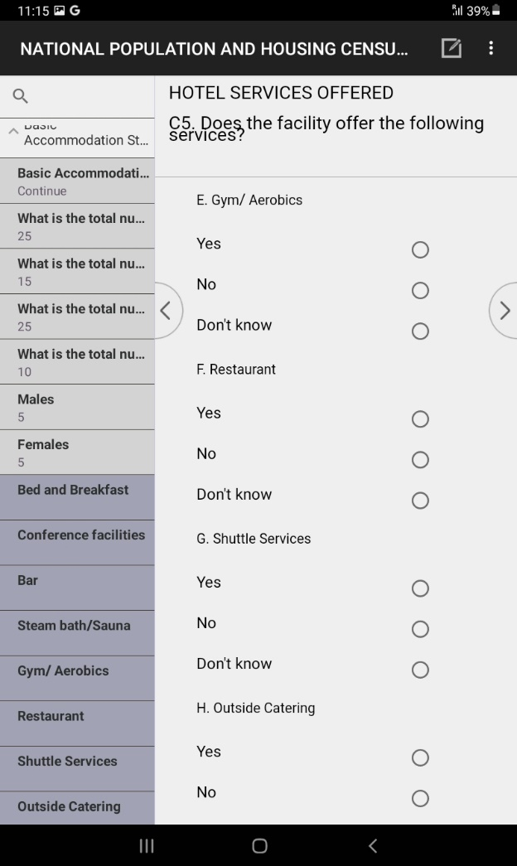
Continue asking for details of the accommodation facility

Slide 10
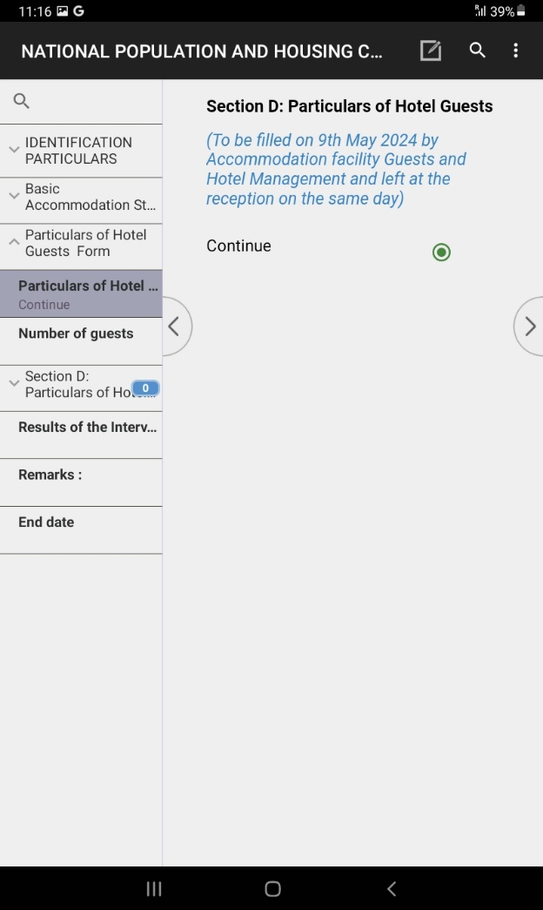
Get The Details of All Persons Who Slept In The Accommodation Facility

Slide 11
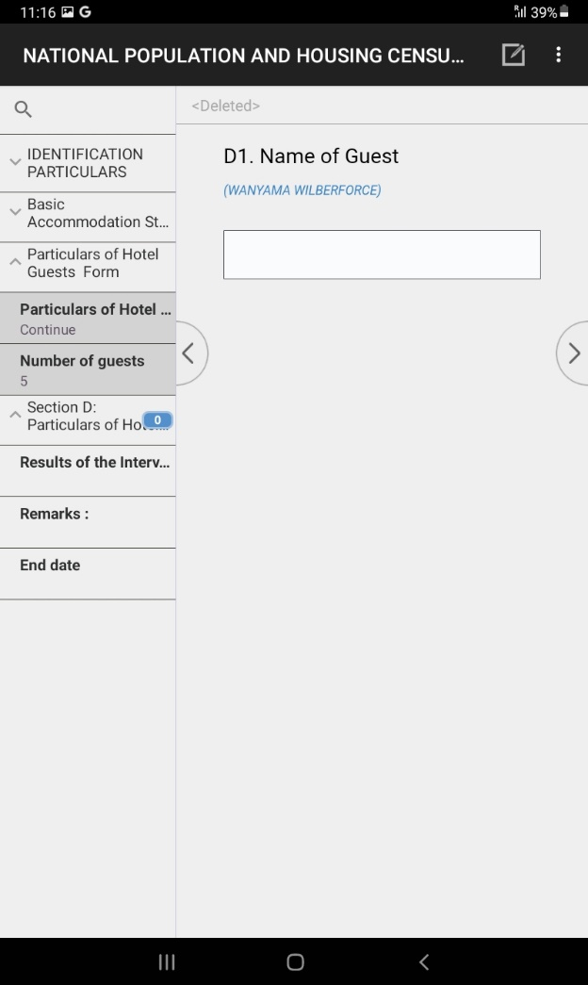
Inputting The Names of All Person Who Slept In The Accommodation Facility

Slide 12
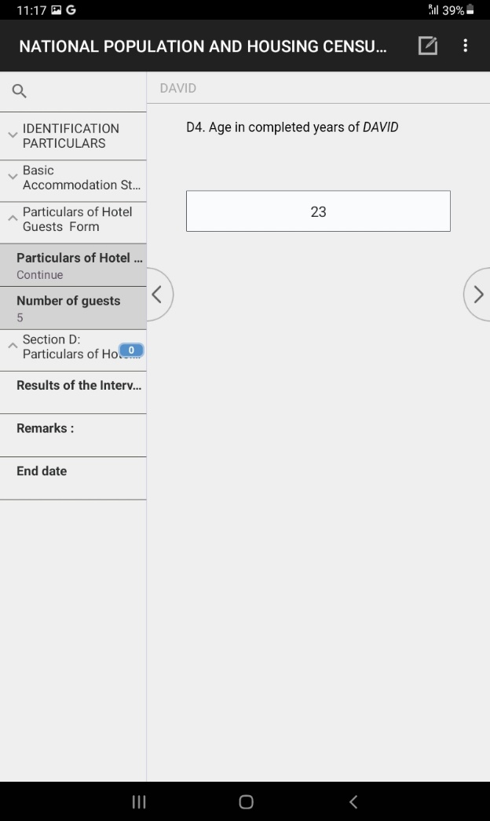
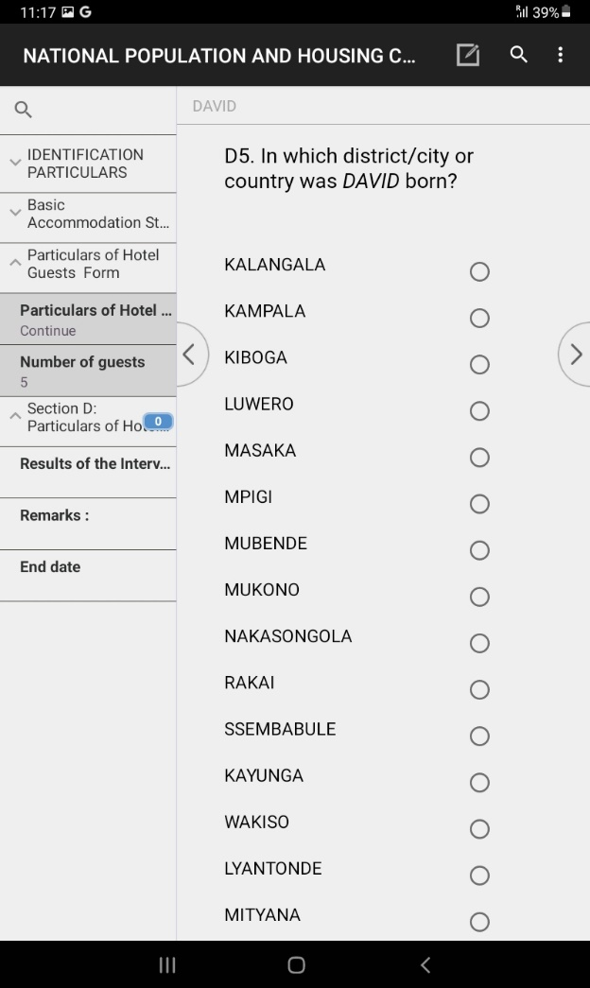
Inputting The Details of All Person Who Slept In The Accommodation Facility Cont…

Slide 13
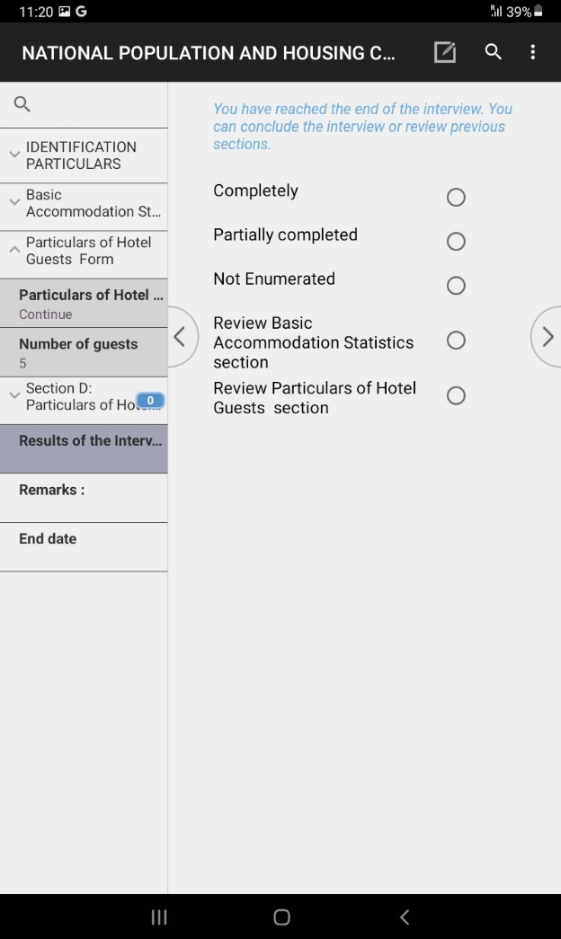
Select The Status of The Interview You Have Just Conducted

Slide 14
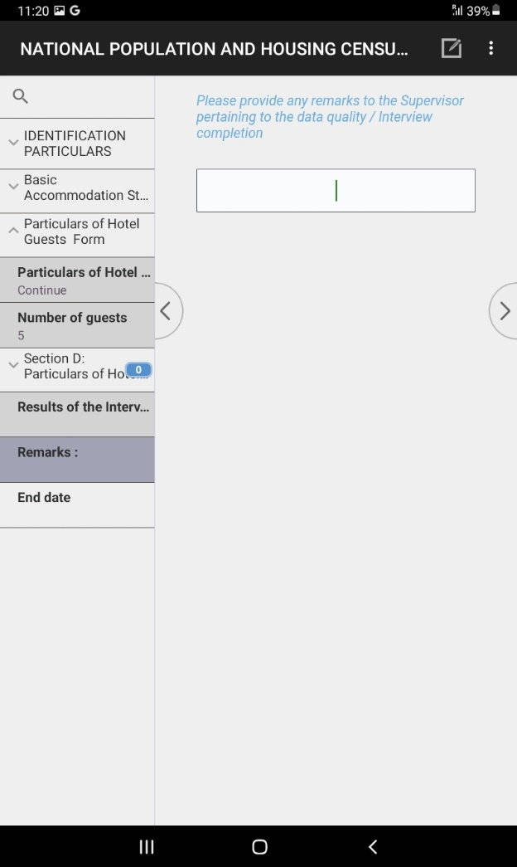
Give Your Comment of The Interview You Have Just Finished

Slide 15
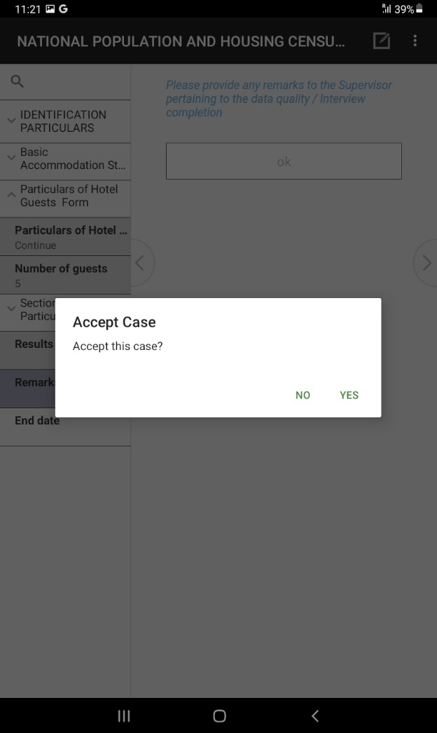
Finally Accept The Questionnaire You Have Done And Save It

Slide 16
Thank You
Any Questions

