Slide 1
  NATIONAL POPULATION AND HOUSING CENSUS 2024
  INTRODUCTION TO CAPI

Slide 2
PRESENTATION OUTLINE
Introduction
Why CAPI?
Tablet Basics
Handling tablets and Accessories
Basic Troubleshooting
Challenges of CAPIP
Possible solutions
Rules Governing the use of tablet for fieldwork

Slide 3
Introduction
The 2024 Population and housing Census in Uganda will be the first digital census aided with use of Computer-Assisted Personal Interviewing (CAPI) method.
CAPI is a technology that uses mobile devices i.e. tablets , the internet or cellular networks to enable field officers to collect data in the field.
The Enumerator uses a tablet to enter responses during the face-to-face interview process

Slide 4
Introduction cntd…
The Bureau uses different applications for data collection. One is CSPro.
The Census and Survey Processing System (CSPro) software package was used to develop the 2024 NPHC data collection system.
CSentry which is a component of CSPro, will be used to run the 2024 NPHC application on android devices.

Slide 5
Why CAPI
Timelines
• Reduces the time lag between data collection and publication of results because data collection and entry are fused into one process.
There is real time monitoring of coverage.
Quality data is collected
There are real time prompts incase of errors made that enable the Enumerator to correct before proceeding.
Uses the functionality of GPS.

Slide 6
Why CAPI ctnd…
Enhances data protection:
• safeguarding important information from damage, compromise or loss (server acts as backup).
• data can be restored quickly after any damage or loss.
• data privacy is maintained.
Costs:
• Data entry costs are negated.
• Save on the cost of paper.
• Save on the cost of storage of paper questionnaires.

Slide 7
Why CAPI ctnd…
Confidentiality, Integrity and Availability(CIA)
• Confidentiality: information is not disclosed to unauthorized individuals and institutions .
• Integrity: maintaining accuracy and completeness of data ie data cannot be modified in an unauthorized way. A secure connection will be used to ensure data safety of data while in transmission.
• Availability: information is available when needed.

Slide 8
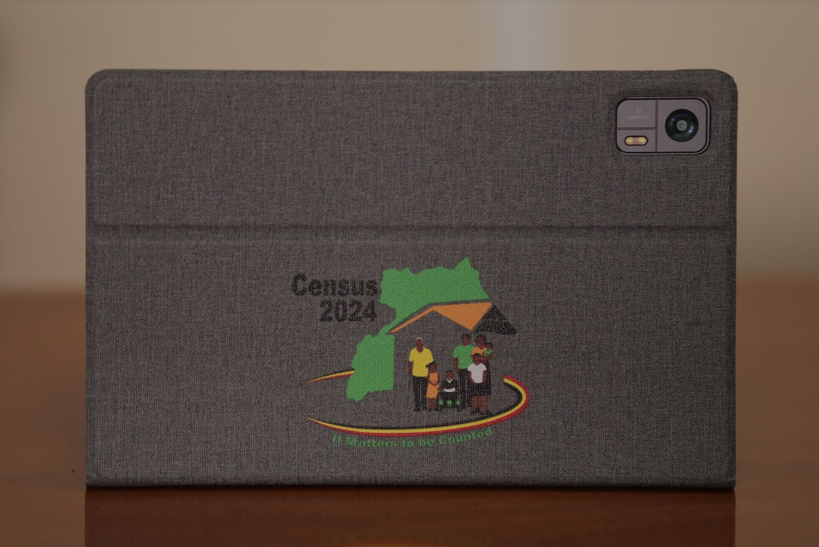
Tablet basics (1/9)
What is a tablet? A tablet is a wireless portable personal computer with a touchscreen as a primary input/output interface.
The tablet will be offered with accessories to aid its functionality i.e. jacket, charger, and power bank.

Slide 9
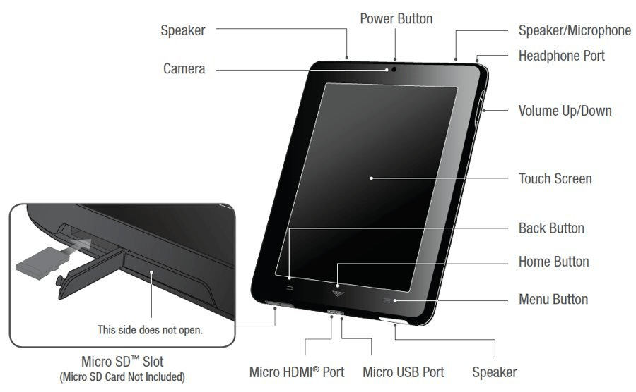
Tablet Basics Cntd…
Features of a tablet

Slide 10
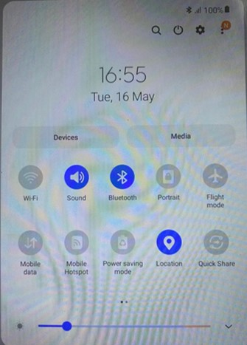
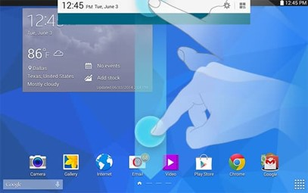
Tablet Basics Cntd…
Tablet Status bar
Swipe from up downwards to access the status bar as shown

Slide 11




Tablet Basics Cntd…
• Bluetooth: Wireless function that connects one tablet to
another within a short range (10m). The Enumerator will use this function to share data with their supervisor.
• Location: Allows the tablet to read the GPS coordinates
• Mobile Data: Internet content delivered to the
tablet over a SIM Card. The supervisor will use this function to synchronize data to HQ server.
• Wi-Fi: Allows the tablet to connect to an external internet source. E.g. Hotspot tethering.

Slide 12
Tablet Basics Cntd…
Date and Time:
The correct date format is DD/MM/YYYY
Setting the correct date and time on the tablet allows for
Complete and accurate data collection which easily references to the periods or durations.
The application uses the date on the tablet to compute things like current age.
This has been preconfigured, if not contact your supervisor
NOTE: The date and time will be configured on the CAPIs

Slide 13
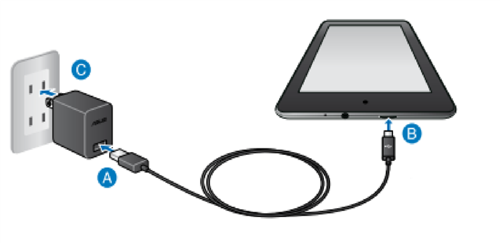
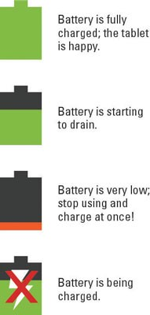
Tablet Basics Cntd…
Charging Tablet Battery
Recharge the tablet battery whenever there is an
opportunity during fieldwork..
Only use the chargers that have been provided with the tablets
Desist from using the tablet while it is charging.

Slide 14
Tablet Basics Cntd…
Battery Management Tips
Turn off Bluetooth
Turn off the data switch
Turn off location when tablet is not in use
Reduce the brightness of the tablet
Close all running applications in the background
Top up charge when the battery drops

Slide 15
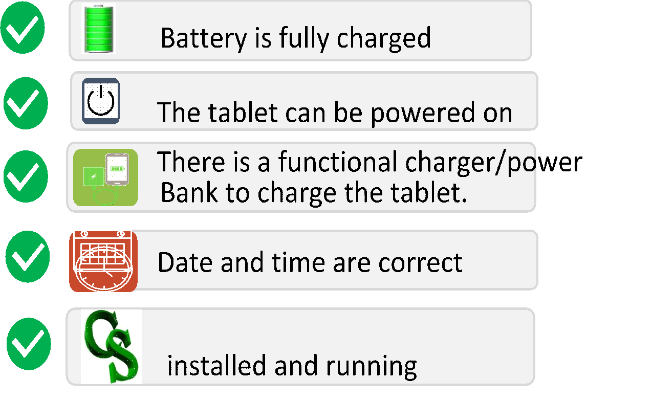
Tablet Basics Cntd…
Checklist Before fieldwork

Slide 16
Handling Tablets and Accessories
Do Not expose the tablet to any liquid substance e.g.
water. If any liquid enters the tablet, stop using it immediately, turn it off, remove all cables connected to it and contact the supervisor.
Do Not place the tablet on the floor to avoid stepping on it or on a bed to avoid lying on it.
Do Not place heavy objects on the tablet to avoid breaking the screen.
Do not: Place or slide the tablet on rough surfaces to avoid scratching the screen.

Slide 17
Troubleshooting
Possible Problem 1: Tablet’s screen turns blank.
Possible solution:
• The tablet may be in “Sleep Mode”; Press on the Power
Button to wake it up.
• Press on the power button for about 5 seconds to check if
the tablet battery has not run out. Charge the battery and
turn on the tablet again.
• Increase the brightness of the tablet if the screen is dimmed.
If problem persists, consult the immediate supervisor.

Slide 18
Troubleshooting
Possible Problem 2: Tablet not turning on (or not booting) after pressing power button (once or a few times)
Possible solution:
• The battery may not be charged. Plug the adapter to a
power outlet and charge it for about 10 mins.
• Turn on the tablet again.
• If tablet still doesn't start, charge for a few minutes more
and try again.
If problem persists, consult the immediate supervisor

Slide 19
Troubleshooting
Possible Problem 3: Tablet freezes while in use
Possible solution:
• Long press power button to restart the tablet
If problem persists, consult the immediate supervisor

Slide 20
Challenges of CAPI
Initial costs and running costs of computer hardware and
related infrastructure.
Needs power (charging Tablets etc.), which may not be
readily available.
Needs internet connectivity for data transmission
CAPI is a high value asset that could be targeted by criminals.
Higher learning curve to use the CAPI other than PAPI
Relatively lower trust of privacy because of the GPS capabilities

Slide 21
Possible Solutions
Power banks will be made available to support constant power supply.
Enumerators share data via Bluetooth and the supervisor looks for an area with connectivity to sync with HQ.
There will be a fully fledged call center to respond to user queries and concerns while in the field in addition to the IT staff. The contacts will be made available.

Slide 22
Possible Solutions
There will be an issue tracker to make sure all reported concerns are attended to and traced to completion.
A step by step working guide will also be provided to users to guide them through the process.
Enumerators encouraged to explain to the interviewees that the data being collected is for statistics and will never be used in isolation.

Slide 23
Rules Governing the use of tablet for Fieldwork (1/2)
Each tablet has been prepared for one Enumerator only, and should be used by that Enumerator alone. Sharing the tablet with unauthorized persons is strictly prohibited.
Do not change the password of the lock screen.
Personal downloads are not allowed.
Supervisors/Enumerators are not allowed to repair or authorize repair of a damaged tablet.

Slide 24
Rules Governing the use of tablet for Fieldwork (2/2)
Do not delete any folder or file from the tablet.
Keep the tablet away from children.
Promptly report lost or stolen tablet or any of its
accessories to your immediate Supervisor.
Ensure confidentiality at all times.
Do not attempt to upgrade, update or download/install
any application on the tablet.
Do not copy data off the device since it is a breach of the Data Protection Law.

Slide 25


Thank You
Any Questions

Slide 26
  PLAY VIDEO 1

Slide 27
  SUPERVISOR & INTERVIEWER | MENUS
  NPHC 2024 TRAINING

Slide 28
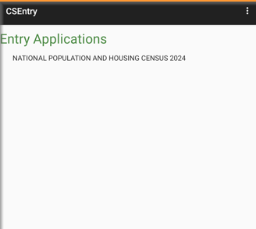
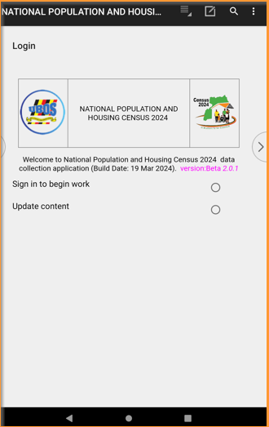
Supervisor
Entry Application
Login

Slide 29
Supervisor
Entry Application
Login

Slide 30
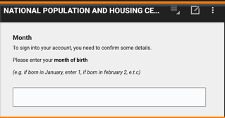
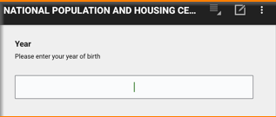
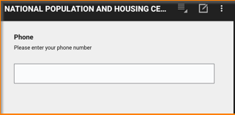
Verification of login details
Carefully enter month, year of birth and your telephone number to begin interview

Slide 31
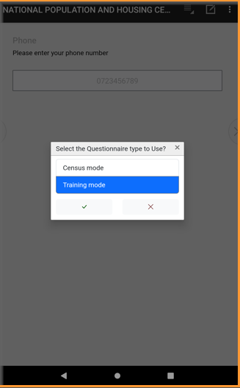
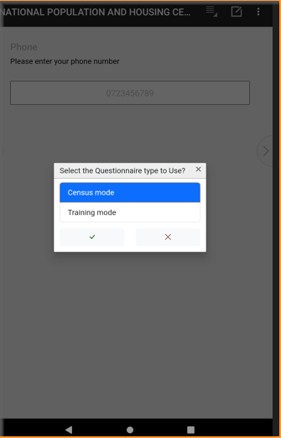
Selecting the Mode
Training Mode
Census Mode

Slide 32
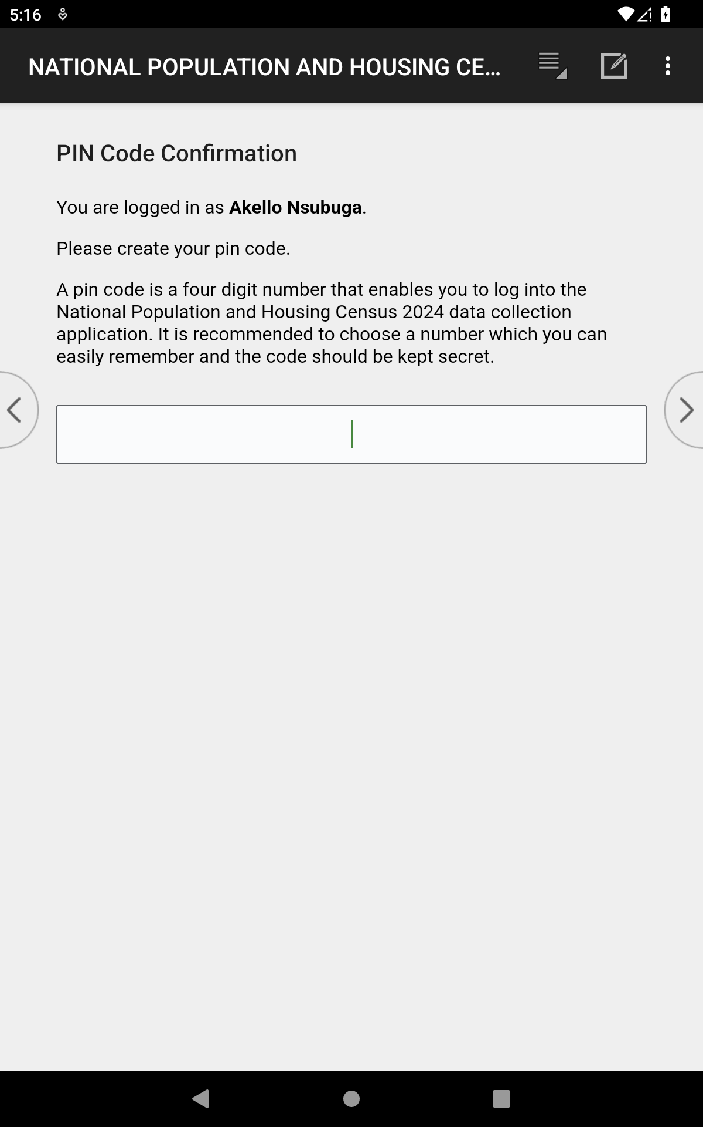
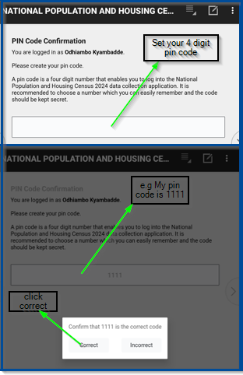
Pin Code
  Set your 4 digit pin code
Notes:
A new screenshot with comments outside

Slide 33
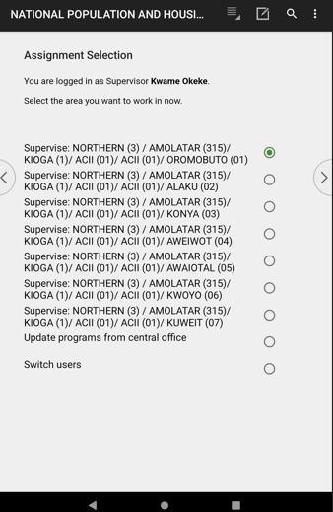
Supervisor Assignment
Select the Village to apply a community questionnaire
Update and switch users

Slide 34
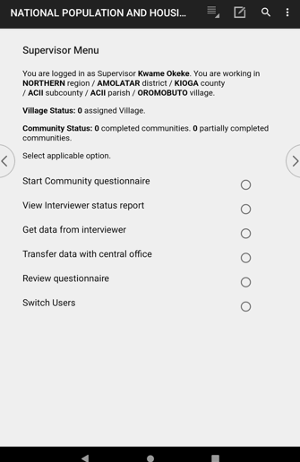
Supervisor Menu: Start Community Questionnaire
Select start community questionnaire to start interviewing
Notes:
Include a screenshot for viewing the status report

Slide 35
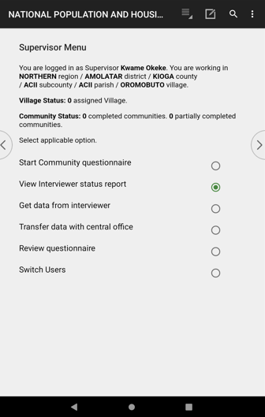
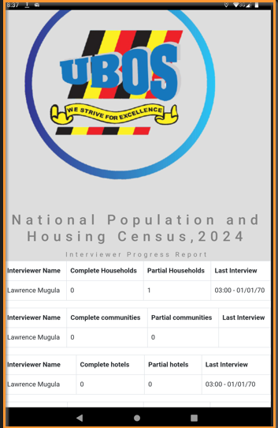
Supervisor Menu: View Status Report
Notes:
Include a screenshot for viewing the status report

Slide 36
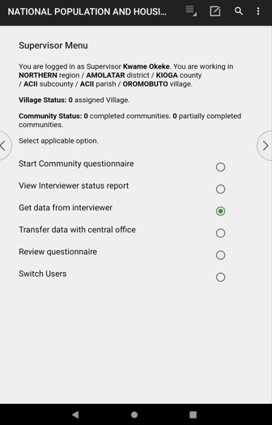
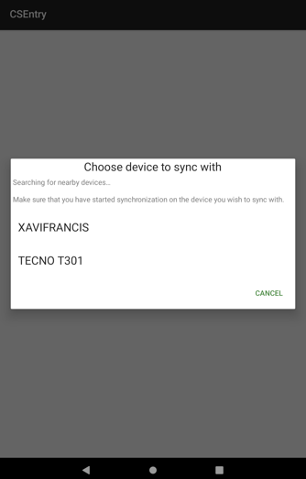
Supervisor Menu: Get data from interviewer

Slide 37
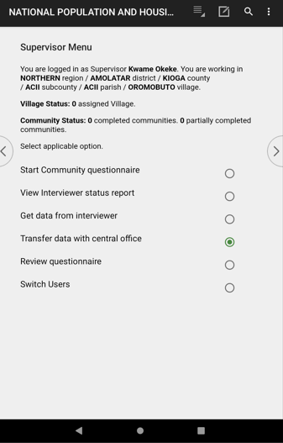
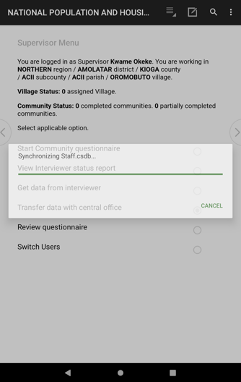
Supervisor Menu: Transfer data with central office
Notes:
Missing screenshot for review questionnaire

Slide 38
Supervisor Menu
Any Questions

Slide 39
  INTERVIEWER | MENU
  NPHC 2024 TRAINING

Slide 40
Interviewer
Entry Application
Login

Slide 41
Verification of login details
Carefully enter month, year of birth and your telephone number to begin interview

Slide 42
Selecting the Mode
Training Mode
Census Mode

Slide 43
Pin Code
  Set your four (4) digit pin code
Notes:
A new screenshot with comments outside

Slide 44
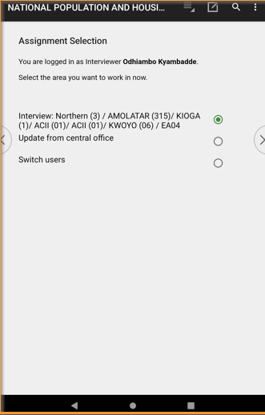
Interviewer Assignment
Select EA to start work
Confirm that you are in the correct EA.

Slide 45
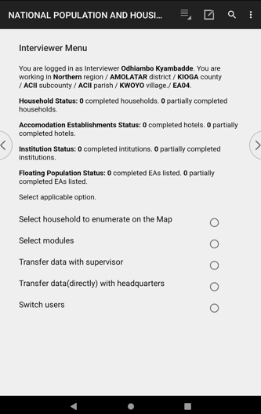
Interviewer Menu (1/6)
1.Summary of questionnaires done
  To view all the questionnaires so far tempted
2.Select Household to enumerate on the map
  To start enumerating your EA by selecting particular households on the map
3.Select Module
To view questionnaires and to continue interviewing if not complete
To start interviewing other questionnaires
To add a new household structure that does not appear on the EA map
4.Transfer data with supervisor
Transfer all the data collected to the supervisor
5.Transfer data (directly) with Headquarter
Send collected data to the Head quarter servers
6.Switch users
  Exit current user to log in as another person
1
2
3
4
5
6

Slide 46
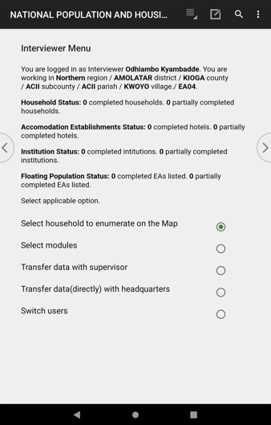
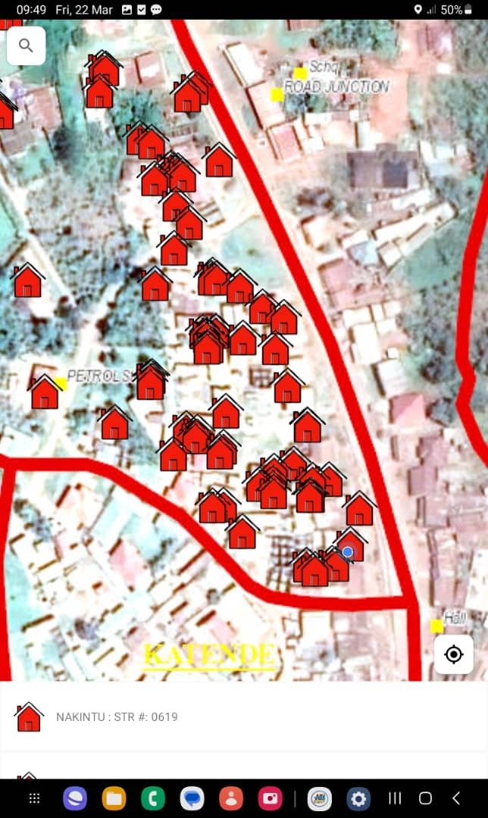
Select Household to enumerate (2/6)
Notes:
Waiting on screenshot from Butambala

Slide 47
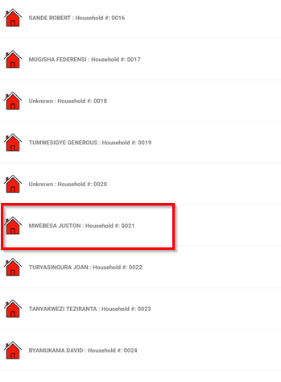
Select Household to enumerate (2/6)
All Households within the EA will populate
Tap/Click the household to begin with
All listed HHs during listing are automatically populated

Slide 48
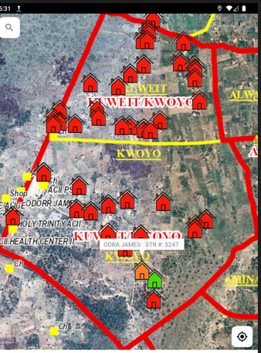
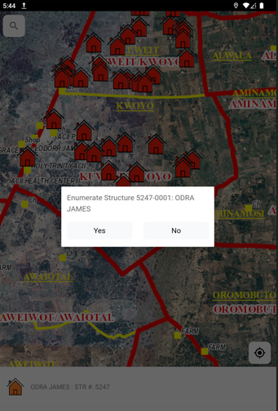
Select Household to enumerate (2/6)
Select Yes if that is the HH to interview

Slide 49
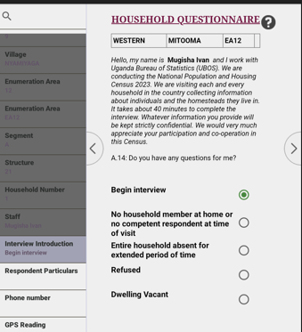
Begin a house hold interview
Begin interview!

Slide 50
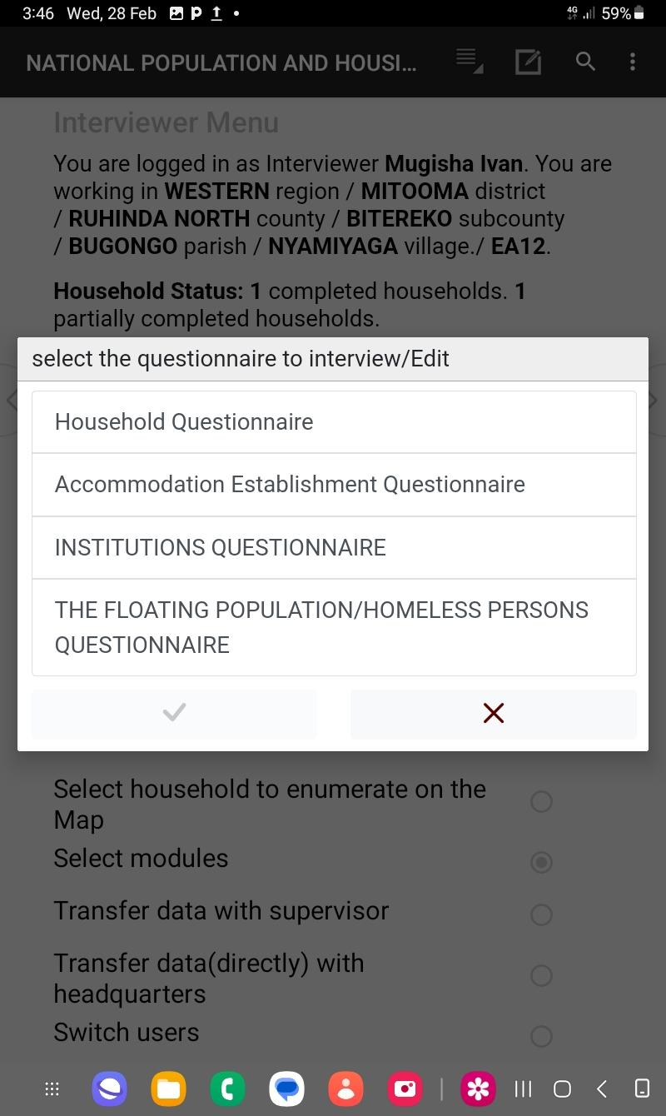
Interviewer Menu (2/6)
Option 3: View questionnaire allows you to select any questionnaire to start interviewing E.g. Institutions Questionnaire

Slide 51
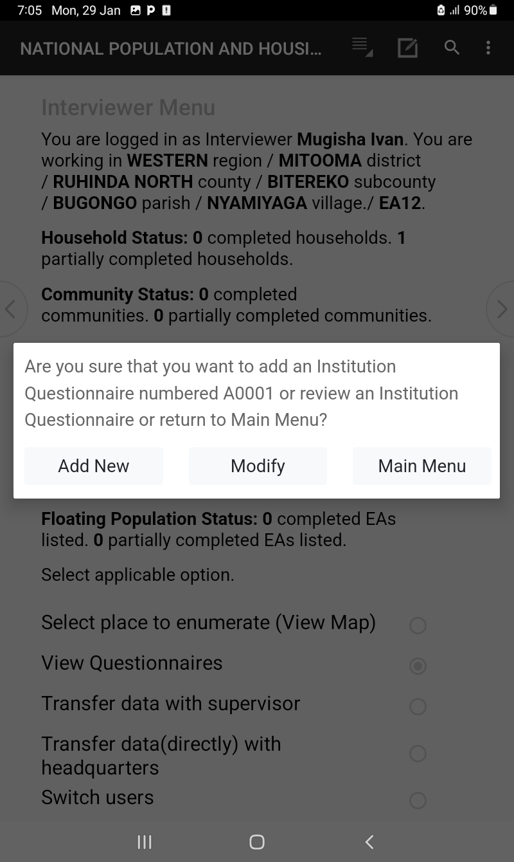
Interviewer Menu (3/6)
After selecting the institutional questionnaire, decide on whether to add new questionnaire, or modify the existing questionnaires, or return back to the interviewer menu

Slide 52
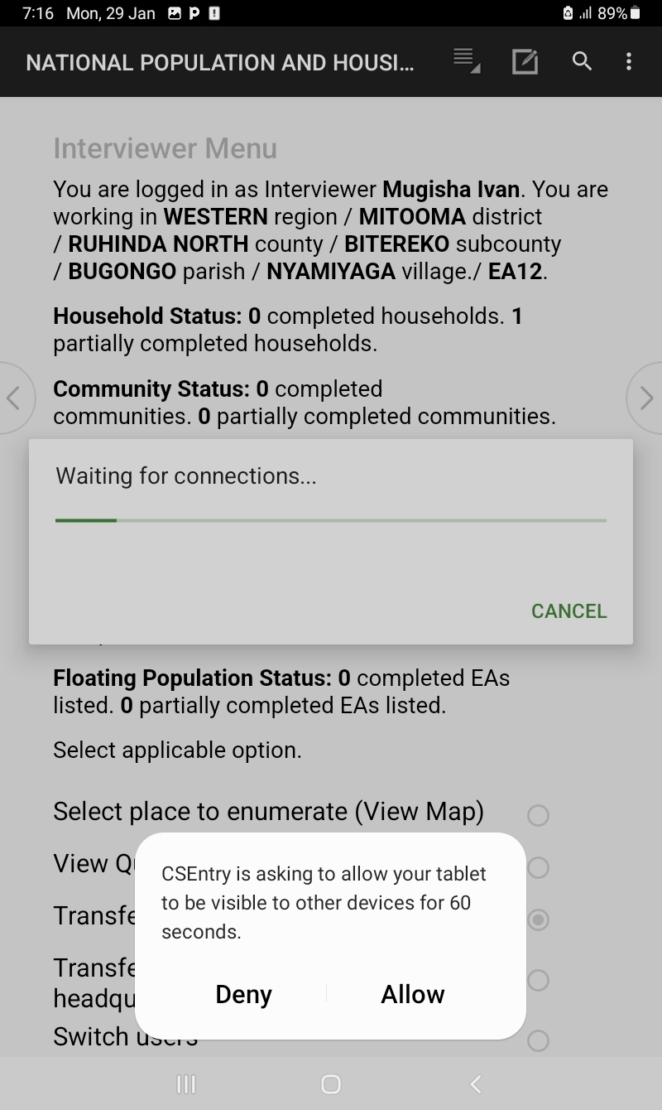
Interviewer Menu (4/6)
Option 4: Allows you to transfer your data to your supervisor

Slide 53
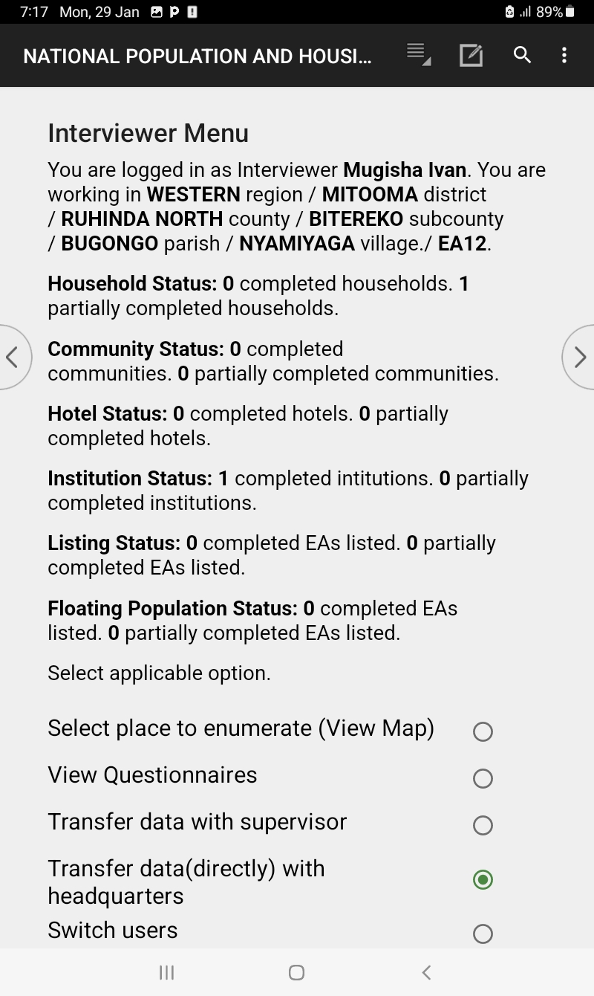
Interviewer Menu (5/6)
Option 5: Allows you to transfer your data to the headquarter servers

Slide 54
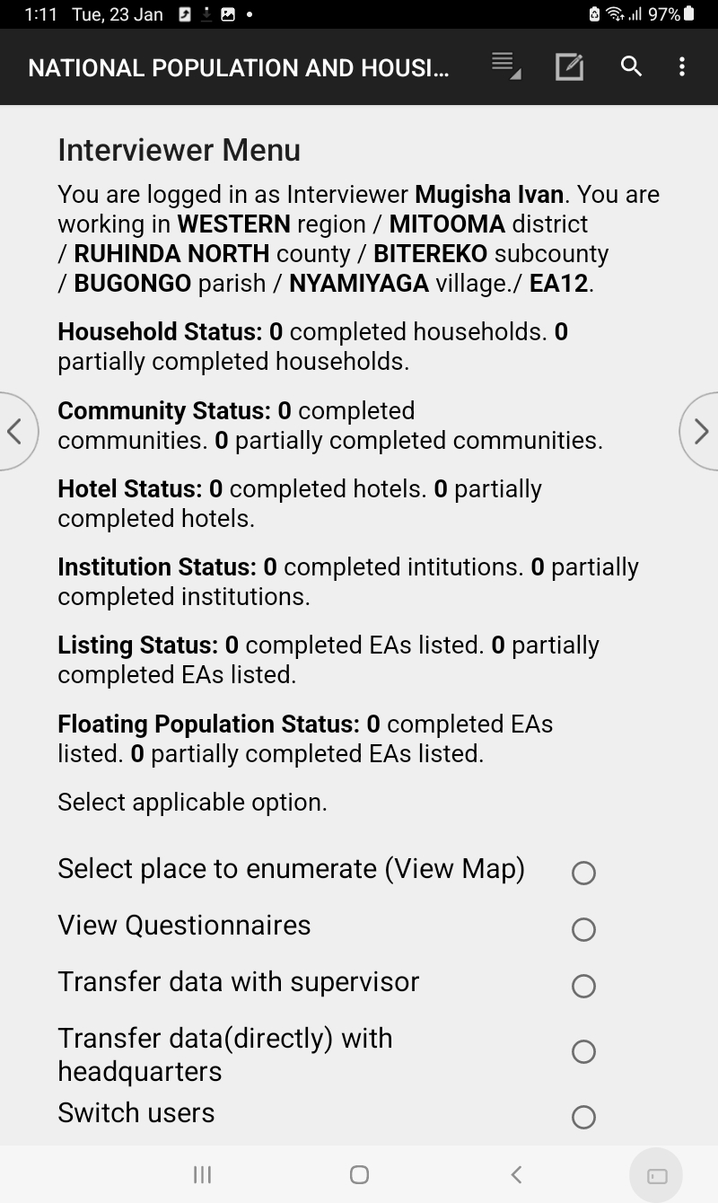
Interviewer Menu (6/6)
Option 6: Allows you to exit the menu to the login screen

Slide 55
Thank You
Any Questions

Slide 56
  PLAY VIDEO 2

Slide 57
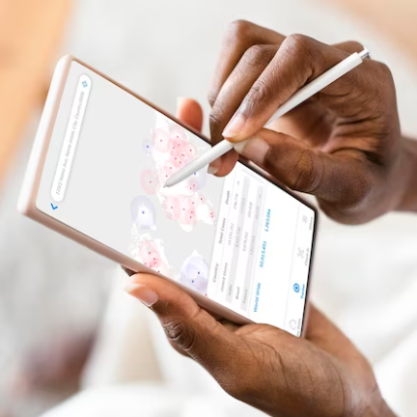
  DATA COLLECTION INSTRUCTIONS USING CAPI
  NPHC 2024 TRAINING

Slide 58
CAPI SYSTEM COMPONENTS
Field Data Management applications
Menu Controlling tasks for interviewers | Menu controlling tasks for supervisors
Data Collection applications
Household questionnaire
Community questionnaire
Institution questionnaire
Accommodation questionnaire
Floating questionnaire
Central Office System
Receive data from field
Check data consistency
Generate data
Quality analysis
Dashboard for monitoring

Slide 59
Key features of the CAPI interview System
Access to user Manuals
Data Capture screen
Tool bar
CAPI system buttons/icons
Different types of questions
Error messages
Changing interview language
Taking Notes
Partial Save

Slide 60
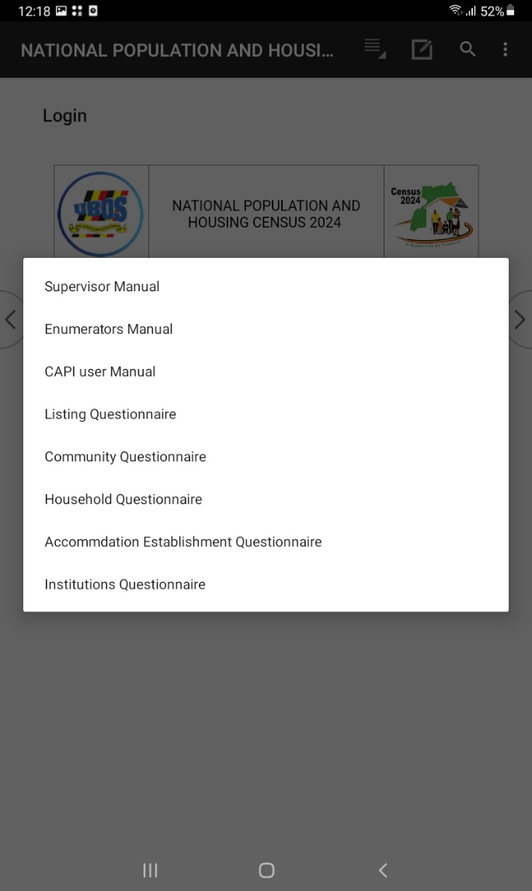
Access to User manuals
Tap the first icon (five lines), to view user manuals.
Select manual of your choice

Slide 61
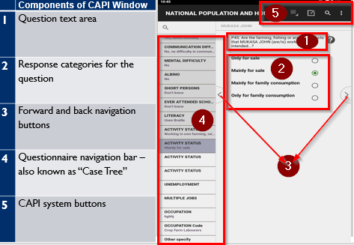
Data Capture Screen (1/2)
Notes:
1 - CAPI defined Buttons 2 - Area for questions 3 - Data capture controls
4 - Fields definition area 5 - Error messages 6 - CSPro status bar information

Slide 62
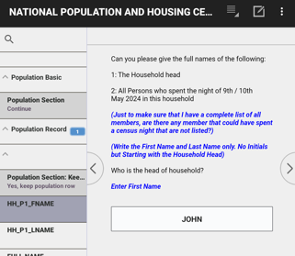
Data Capture Screen (2/2)
Questions and instructions
Black – read out loud respondent
BLUE – instructions for interviewer
Field for data entry

Slide 63
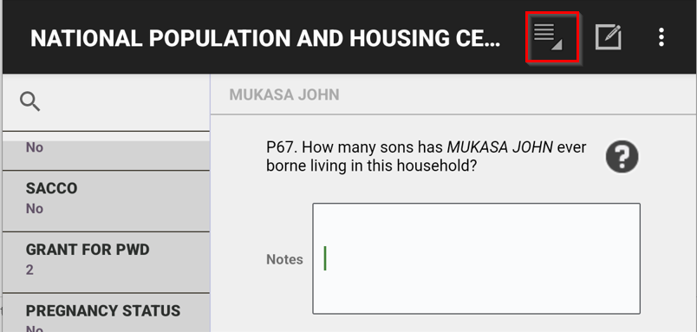
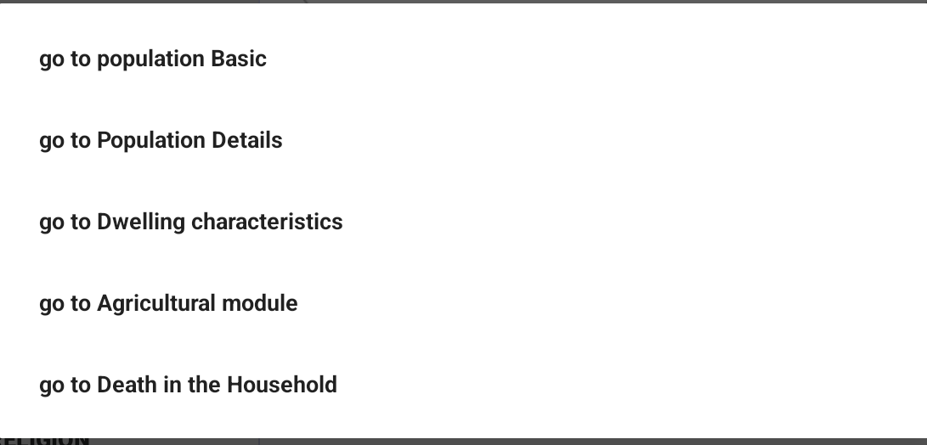
Toolbar - Household

Slide 64
Different types of Questions(1/4)
Radio buttons for single response questions
Check boxes for multiple response questions
Check boxes for multiple response questions with a limit
Open ended numeric responses
Open ended text responses
Questions with major group headings
Pre-filled “protected field” questions

Slide 65
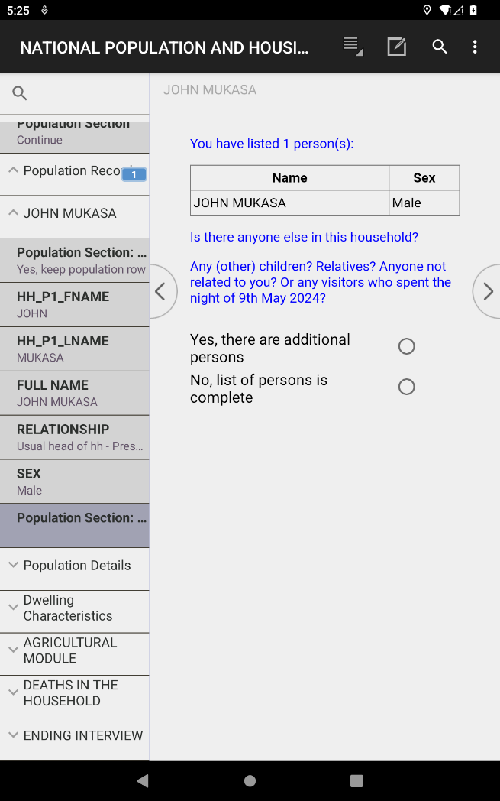
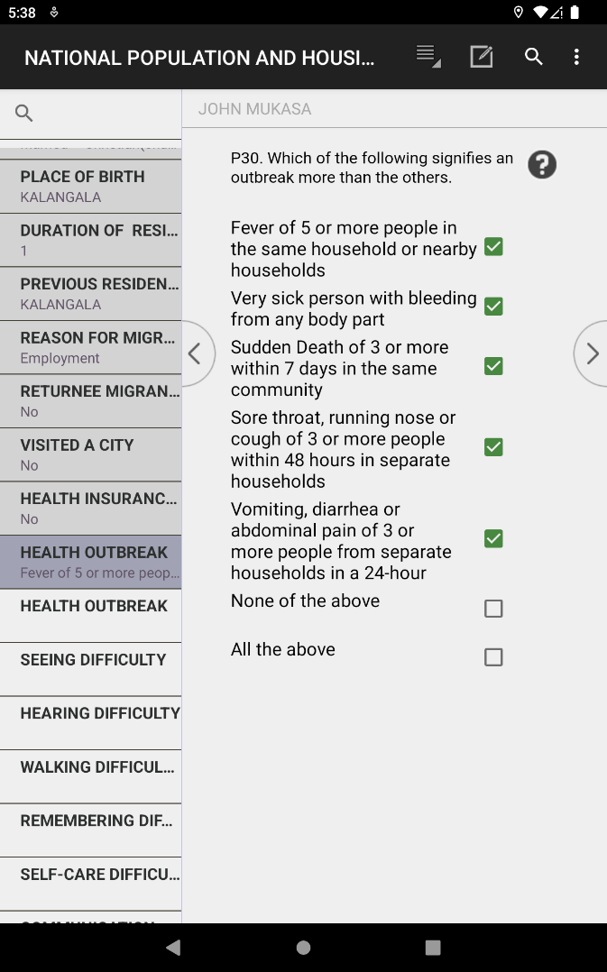
Different types of Questions (2/4)
Single response
Multiple response

Slide 66
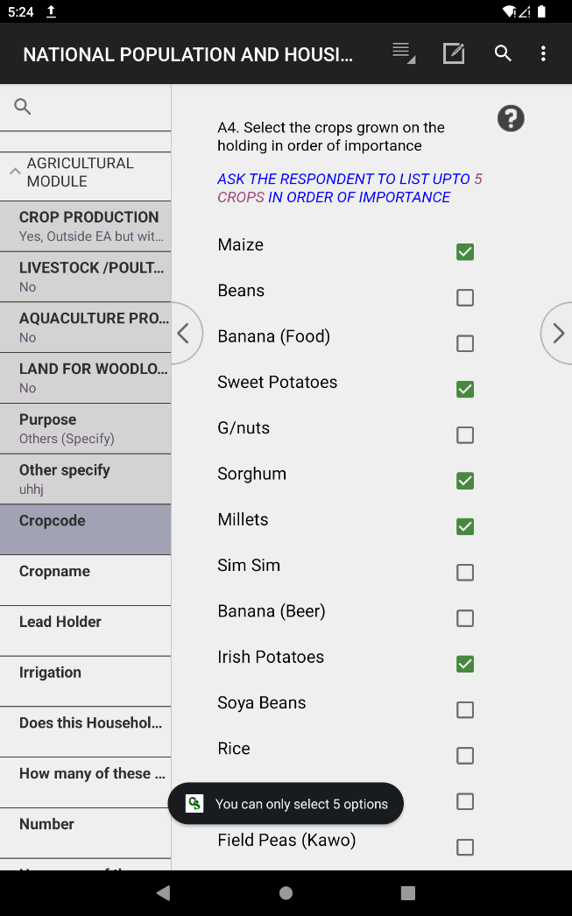
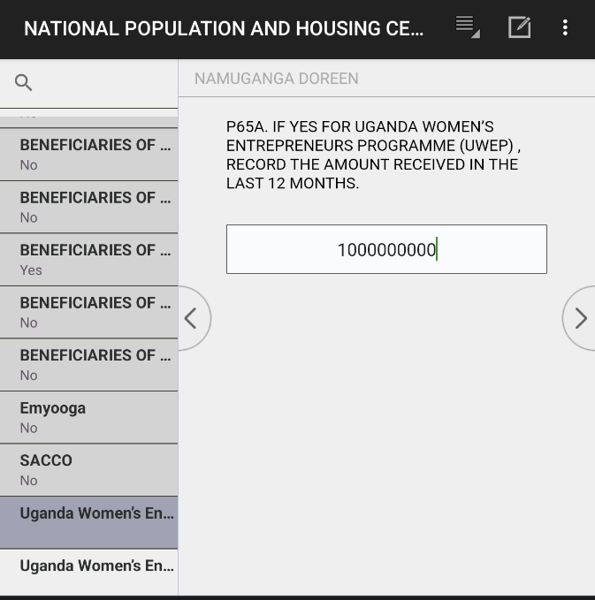
Different types of Questions (3/4)
Multiple choice with limit
Open ended numeric

Slide 67
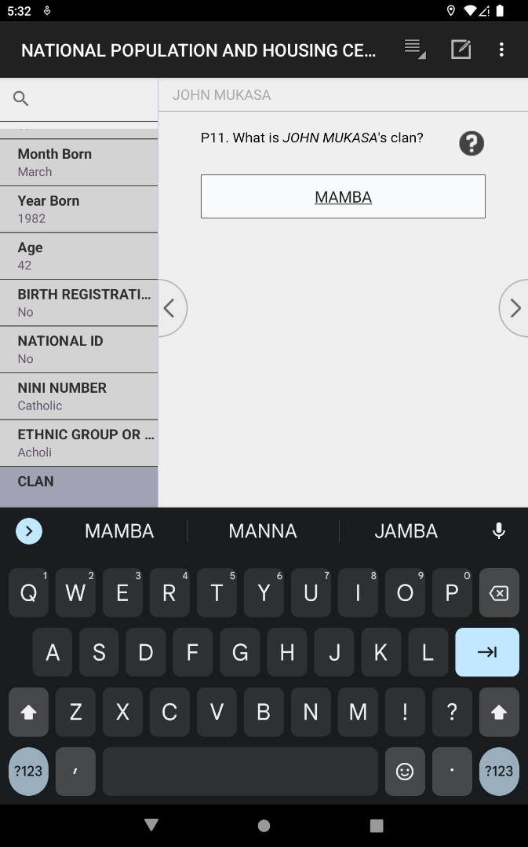
Different types of Questions (4/4)
Open ended text response

Slide 68
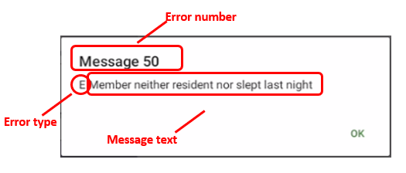
Error/Warning Messages: Structure of message
Message type –
- Warning : may continue without resolving it
- Error: must resolve to continue
Identifying number – use to identify issue and refer to instructions
Message text: describes issue causing message
Notes:
E-error type: Error is critical to the data integrity and as result it need to be corrected
W-error type: Error is not critical to the data integrity, but needs absolute attention before dismissing

Slide 69
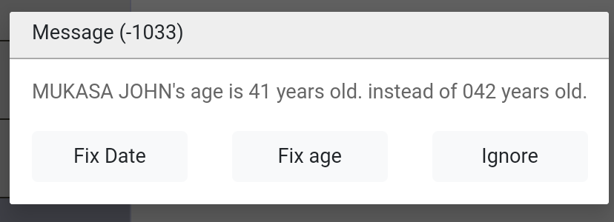

Error Messages
Warning message will allow to continue (note ‘W’ letter)
Error message requires correction before continuing (note ‘E’ letter)
Notes:
First type: The error provides buttons to return to two or more of the intervening questions that cause the error. It is a warning and by pressing “Continue” button, it allows to continue with the next applicable question.
Second type: The error provides buttons to return to two or more of the intervening questions that cause the error

Slide 70

Changing interview language -Swahili Translation

Slide 71


Taking Notes
Click on ‘Note’ icon at top of screen
Note will be associated with the current question
Type text to record note and then click “>” to continue

Slide 72
Partial Save of interview (1/4)
CAPI system automatically saves data at the end of each form/section
Sometimes interviewer may need to stop interview before it is completed and come back later.

Slide 73



Steps for partial save of interview (2/4)
Method 1
Click on Android “Back” button at bottom left of screen. Note this is the Android back button not the CSPro button that moves back one field.
Notes:
To do so:
- Use Back Button menu to exit interview
- Select “Partial save” at prompt
Can also use “Save Partial” option from CAPI system menu to save all data entered, but this will not exit the interview
The Partially saved Household will display with an orange color.

Slide 74


Steps for partial save of interview (3/4)
Method 2
Click on the 3 dots on the extreme right corner
Notes:
To do so:
- Use Back Button menu to exit interview
- Select “Partial save” at prompt
Can also use “Save Partial” option from CAPI system menu to save all data entered, but this will not exit the interview
The Partially saved Household will display with an orange color.

Slide 75


Partial save of interview (4/4)
Revisit partial Household: Go to Interviewer Menu select place to enumerate(View map) Swipe to display the list of all Household

Slide 76
Thank You
Any Questions

Slide 77
  PLAY VIDEO 3

Slide 78
  Starting EA Household interviews using |CAPI
  NPHC2024 TRAINING

Slide 79
What? When? Who? Where?
What? – Begin the EA household interview using CAPI menus
When? – After locating the household within the assigned EA
Who? – Interviewers/ Enumerators
Where?- In the household

Slide 80
Assignment Selection
Select EA to start work
Confirm that you are in the correct EA.

Slide 81
Household Enumeration
Notes:
Waiting on screenshot from Butambala

Slide 82
Selecting the Household to interview
All Households within the EA will populate
Tap/Click the household to begin with
All listed HHs during listing are automatically populated

Slide 83

Selecting 2024 NPHC Household
Select Yes if that is the HH to interview

Slide 84
Begin a HH interview
Begin interview!

Slide 85
Begin HH interview
Geographical variables automatically populated
Date and time filled
Select 'Begin interview' to begin the interview
Read consent statement and enter result of consent

Slide 86

Begin with the population section
Begin with the population section. Select continue move to next questions

Slide 87
Begin HH interview
Start listing HH members starting with the HH head

Slide 88
Household listing asked in two parts
1. Names of household members
Repeats for each person in the household
Questions asked: First Name, Last Name, Relationship to HH head and sex

Slide 89


Household listing asked in two parts…
Add another HH member
No more HH member?
Notes:
Ask name, relationship and sex
At end of each set of questions there is a question “Are there any other persons living in this household?”
If answer is yes, there are additional persons, CAPI system will add an entry for another household member and repeat the set of questions

Slide 90
Particulars of HH members
2. Household Schedule – questions P4 – P87 repeated for each member.
Notes:
Insert a slide that shows the beginning of the house hold members particulars
Add a slide for the 4 modules of the HH questionnaire i.e. characteristics, agriculture, women, death

Slide 91

Begin Housing and Household Characteristics

Slide 92

Begin Agriculture section

Slide 93

Death in the Household section

Slide 94

Ending Interview

Slide 95
Exercise: Household questionnaire
Click the CSPro icon on your tablet screen
Select NATIONAL POPULATION AND HOUSING CENSUS 2024
Enter your Month, Year and telephone Number
Use the EA assigned to you and select the Household to begin with
Follow the mock interview and enter information carefully as it is given by the respondent.

Slide 96
Thank You
Any Questions

